Slide 1
QRA INCLUDING UTILITY FOR DECISION SUPPORT OF H2 INFRASTRUCTURE LICENSING
QRA (by BBN) → utility → decision making
Hans J. Pasman and William J. Rogers
Mary Kay O’Connor Process Safety Center,
Artie McFerrin Department of Chemical Engineering
Texas A&M University, College Station, Texas 77843-3122, USA, hjpasman@gmail.com
CONTENTS
Introduction
Bayesian Network and Influence Diagram Methodology
Risk Analysis Hydrogen Distribution System
Results
Utility and Decision Tree for Governance
Uncertainties and Public Perception
Conclusions
ICHS 2011, San Francisco, Sep 12-14

Slide 2
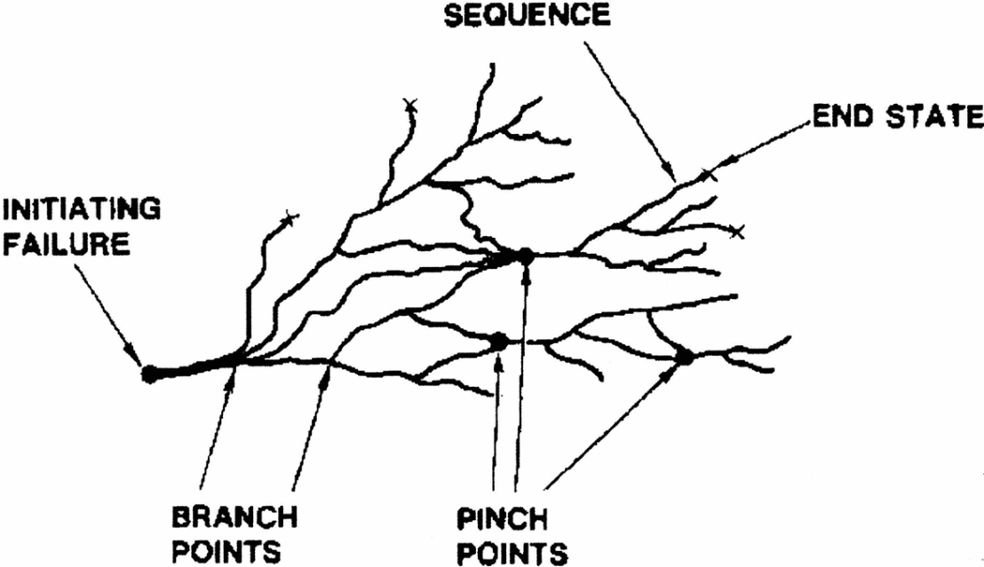
Why QRA with BBN?
QRA builds on scenarios; BBN consists of nodes connected by arcs; = acyclic digraph like FT, ET, bowtie, but more suitable to depict scenarios.
Managements, public, authorities expect certainty when we are asked to predict safety risks. However, QRA is full of uncertainty; moreover software is bulky, not flexible and not transparent.
Now are available discrete and continuous distribution BBN tools with operators, arithmetic, logical/conditional functions.
Scenarios do not only branch, but also pinch!
There are events leading to the same follow-on event: (cascading, escalating, coincidental events merging).
There are time influences, human interventions, conditions of various kinds

Slide 3
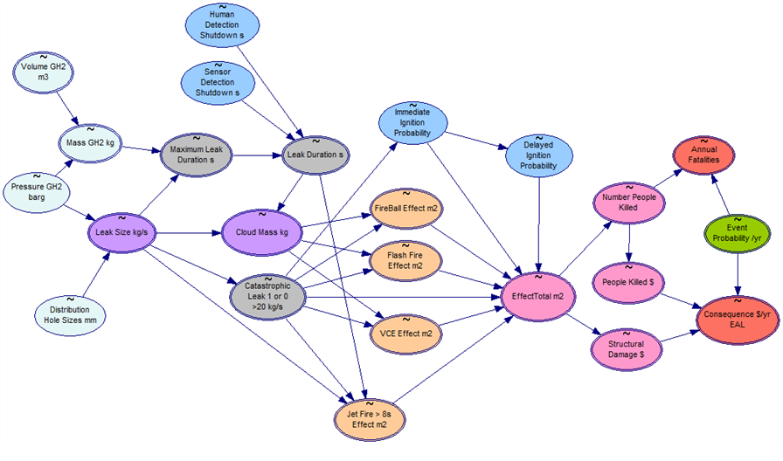
Example BBN H₂ tank station (compressed)
GeNIe/SMILE, Decision Systems Laboratory, University of Pittsburgh, free downloadable.
Runs under MS Windows operating system; compatible with MS Excel

Slide 4
Why Bayesians?
Many possibilities in scenarios; deterministic approach possible but not do-able, only probabilistic tools work (random distributions, stochastic variables)
Crux of Bayesian approach is improving existing knowledge by using new information. (Posterior = Prior distribution × Likelihood by new data)
Safety is learning from the past. This approach applies to data and to models.
BBN software developed by artificial intelligence groups provides easy handle
Bayesian Belief Nets can reflect transparently scenario complexities.
In addition, they can be extended to Influence Diagrams including options and sensitivity analysis. This approach enhances decision making.
Bayesian is particularly useful in case of few data and uncertainty. Belief alludes to subjective probability and the inclusion of expert opinion.

Slide 5
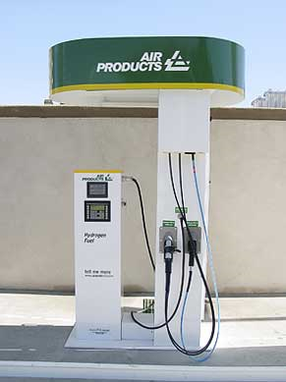
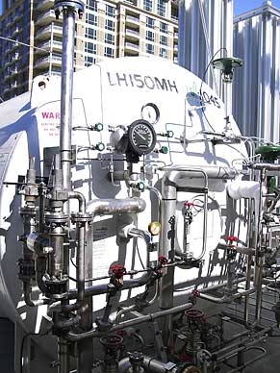
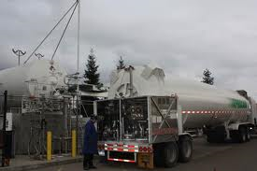
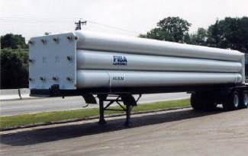
Example case of H₂ refueling stations and tank trucks
Top: Compressed H2 station
Bottom: Liquid H2 truck
Top right: Liquid H2 station
Bottom: Compressed H2 truck

Slide 6
Input data for four H₂ storage tanks + pipe line
H2 store | Pressure bar | Store Capacity kg | Event Frequency /yr | Ref. | Note | Hole size distribution fitted to literature data
GH2TS | 30-200 | 960 | 1.00E-02 | 2 |  | Lognormal (μ = 0.085, s = 0.9)
GH2TT | 30-160 | 300 | 5.33E-03 | 3 | a | 1+10*Binomial (μ = 2, s = 0.3)
GH2PL | 24 | 270 | 5.40E-03 | 3,5 | b | Bernoulli(0.33)= rupture/large leak = 0.33:0.67
LH2TS | 8 | 800 | 1.00E-03 | 3 |  | -200*Weibull (λ= -0.26, k = 0.62)
LH2TT | 8 | 4000 | 2.50E-04 | 3 | c | Bernoulli (0.3) = rupture/large leak = 0.3:0.7
Notes: | a. Compressed gas trucks make 1333 hauls annually, driving 10 km urban freeway at 2.10⁻⁶ accidents/km and 5 km urban road at 6.10⁻⁶ /km with 5% chance of a leak per accident yielding 3.33.10⁻³ release event per year. To this is added 2.10⁻³ /yr rate of failure of the tubes in static condition included in GH2TS.
 | b. An event can result in rupture or large hole leak. The effect of pinhole leaks is neglected. c. The truck makes 100 trips/yr at an assumed chance of 0.05 of a release in case of accident.

Slide 7
Scaled 50% lethal effect area equations developed for various types of fires and vapor cloud explosion (SI units: area in m², mass in kg, leak size in kg/s).
Effect m² | Case | Catastrophic leak | Leak
Jet fire | GH2TS/TT | 0 | π*15*LeakSize (+π*15*LeakSize, if leak duration >8 s)
 | GH2PL | π*4*4 | π*2*2
 | LH2 | 0 | π*18*0.75*66*0.75*(LeakSize/30.4)/2 (+π*18*0.75*66*0.75*(LeakSize/30.4)/2, if duration >8 s)
Flash fire | GH2TS/TT | π*60*4*(CloudMass/52)^0.333 | π*45*3.7*(CloudMass/52)^0.333
 | GH2PL | π*(100/2)*10/2 | 0
 | LH2 | π*18.6*121*(CloudMass/800)^0.333 | π*15.4*88*(CloudMass/800)^0.333
Fire ball | GH2TS/TT | π*(25^2)*(CloudMass/300)^0.333 | 0
 | GH2PL | 0 | 0
 | LH2 | π*(25^2)*(CloudMass/300)^0.333 | 0
Pool fire | GH2 | 0 | 0
 | LH2 | π*((0.0158*((CloudMass/71)^0.43)^2+3.8121*(CloudMass/71)^0.43)*2)^2
Vapor Cloud Expl. | GH2TS/TT | π*(25^2)*(CloudMass/20)^0.333 | π*(25^2)*(CloudMass/40)^0.333
 | GH2PL | π*(78^2)*(CloudMass*0.5/300)^0.333 | 0
 | LH2 | π*(62^2)*(CloudMass/300)^0.333 | π*(62^2)*(CloudMass/600)^0.333

Slide 8
In part assumed and otherwise resulting ignition probabilities
.
H2 store | Immediate ignition |  | Fireball | Flash fire | VCE | Jet fire | Pool fire | Safe dispersal
 | Catastrophic | Hole
GH2TS | 0.8 | 0.6 | 0 | 0.10 | 0.10 | 0.60 | 0 | 0.20
GH2TT | 0.8 | 0.6 | 0.05 | 0.10 | 0.10 | 0.55 | 0 | 0.21
GH2PL | 0.5 | 0.5 | 0 | 0.08 | 0.08 | 0.50 | 0 | 0.34
LH2TS | 0.8 | 0.8 | 0.17 | 0.04 | 0.04 | 0.50 | 0.18 | 0.09
LH2TT | 0.8 | 0.8 | 0.19 | 0.03 | 0.03 | 0.44 | 0.20 | 0.11

Slide 9
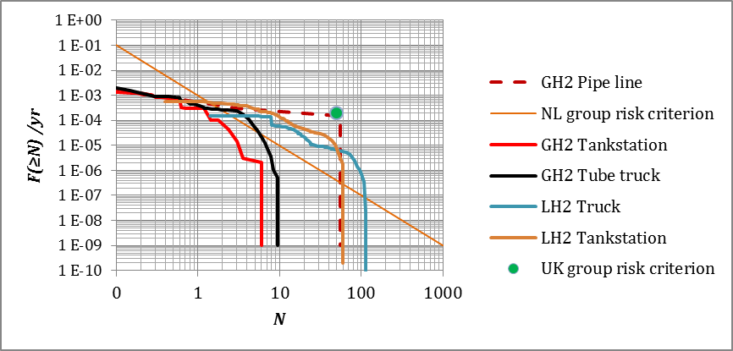
Societal risk F-N curves for the two refueling stations and the three transportation modes
Assumed population density 4000 /km²

Slide 10
Individual risk (IR) distances (per million years, in meter) and Expected Annual Loss (EAL) in 1000 $/yr
System | IR 10⁻⁶/yr Radius | EAL mean | EAL st.dev.
 | m | k$/yr | k$/yr
GH2TS | 16 | 2 | 5
GH2TT | 21 | 3 | 7
GH2PL | 34 | 15 | 21
LH2TS | 67 | 14 | 17
LH2TT | 70 | 7 | 7
EAL is composed of:
- Structural damage
1000 $/m²
- Value of life lost
2 million $/fatality
(rather low)

Slide 11
The result of a risk assessment can be used in different ways:
to investigate where main risks can be found so that preventive or protective risk reducing measures can be taken or embodied in standards and codes.
to plan use of space (land use planning, LUP) or to obtain a license for an activity.
to help emergency response planning (which would benefit from information about expected numbers of injured persons).
to perform business risk management and enable a cost-benefit analysis, CBA.

Slide 12
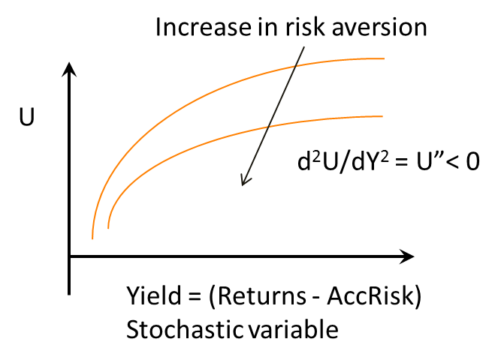
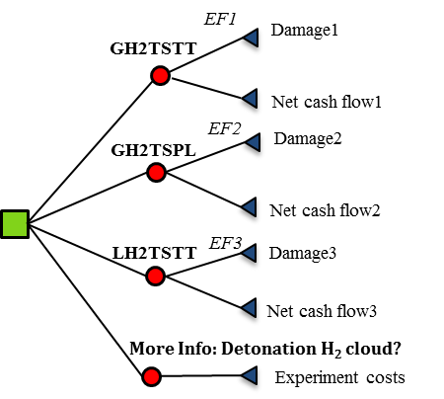
Utility, Uncertainty and Decision Tree
Utility is a way to express feelings of desirability of consequence attributes of a decision; so it can indicate a decision maker’s preferences of risky yield vs. fixed gain
Decision tree of (probabilistic) options:
Concept developed in economics (vN-M).
Desirability depends on wealth and risk.
Decision maker has to be ’calibrated’.
Risk aversion larger with d²U/dY² more neg.
Yield is stochastic: hence E(Y), Var(Y)
Utility decreases with larger uncertainty:
Fixed gain ≈ -0.5(U”/U’)·Var(Y)
Value of information

Slide 13
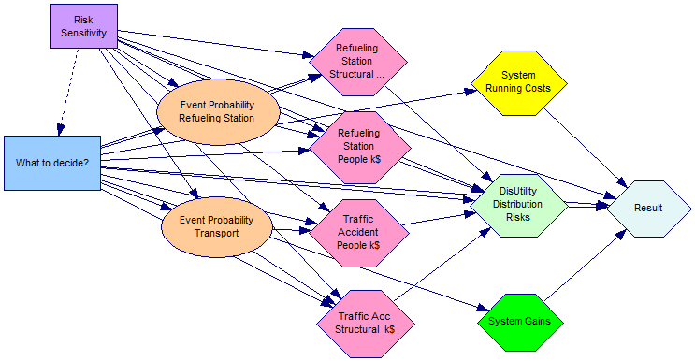
Influence diagram and sensitivity limits
GeNIe/SMILE, Decision Systems Laboratory, University of Pittsburgh, free downloadable

Slide 14
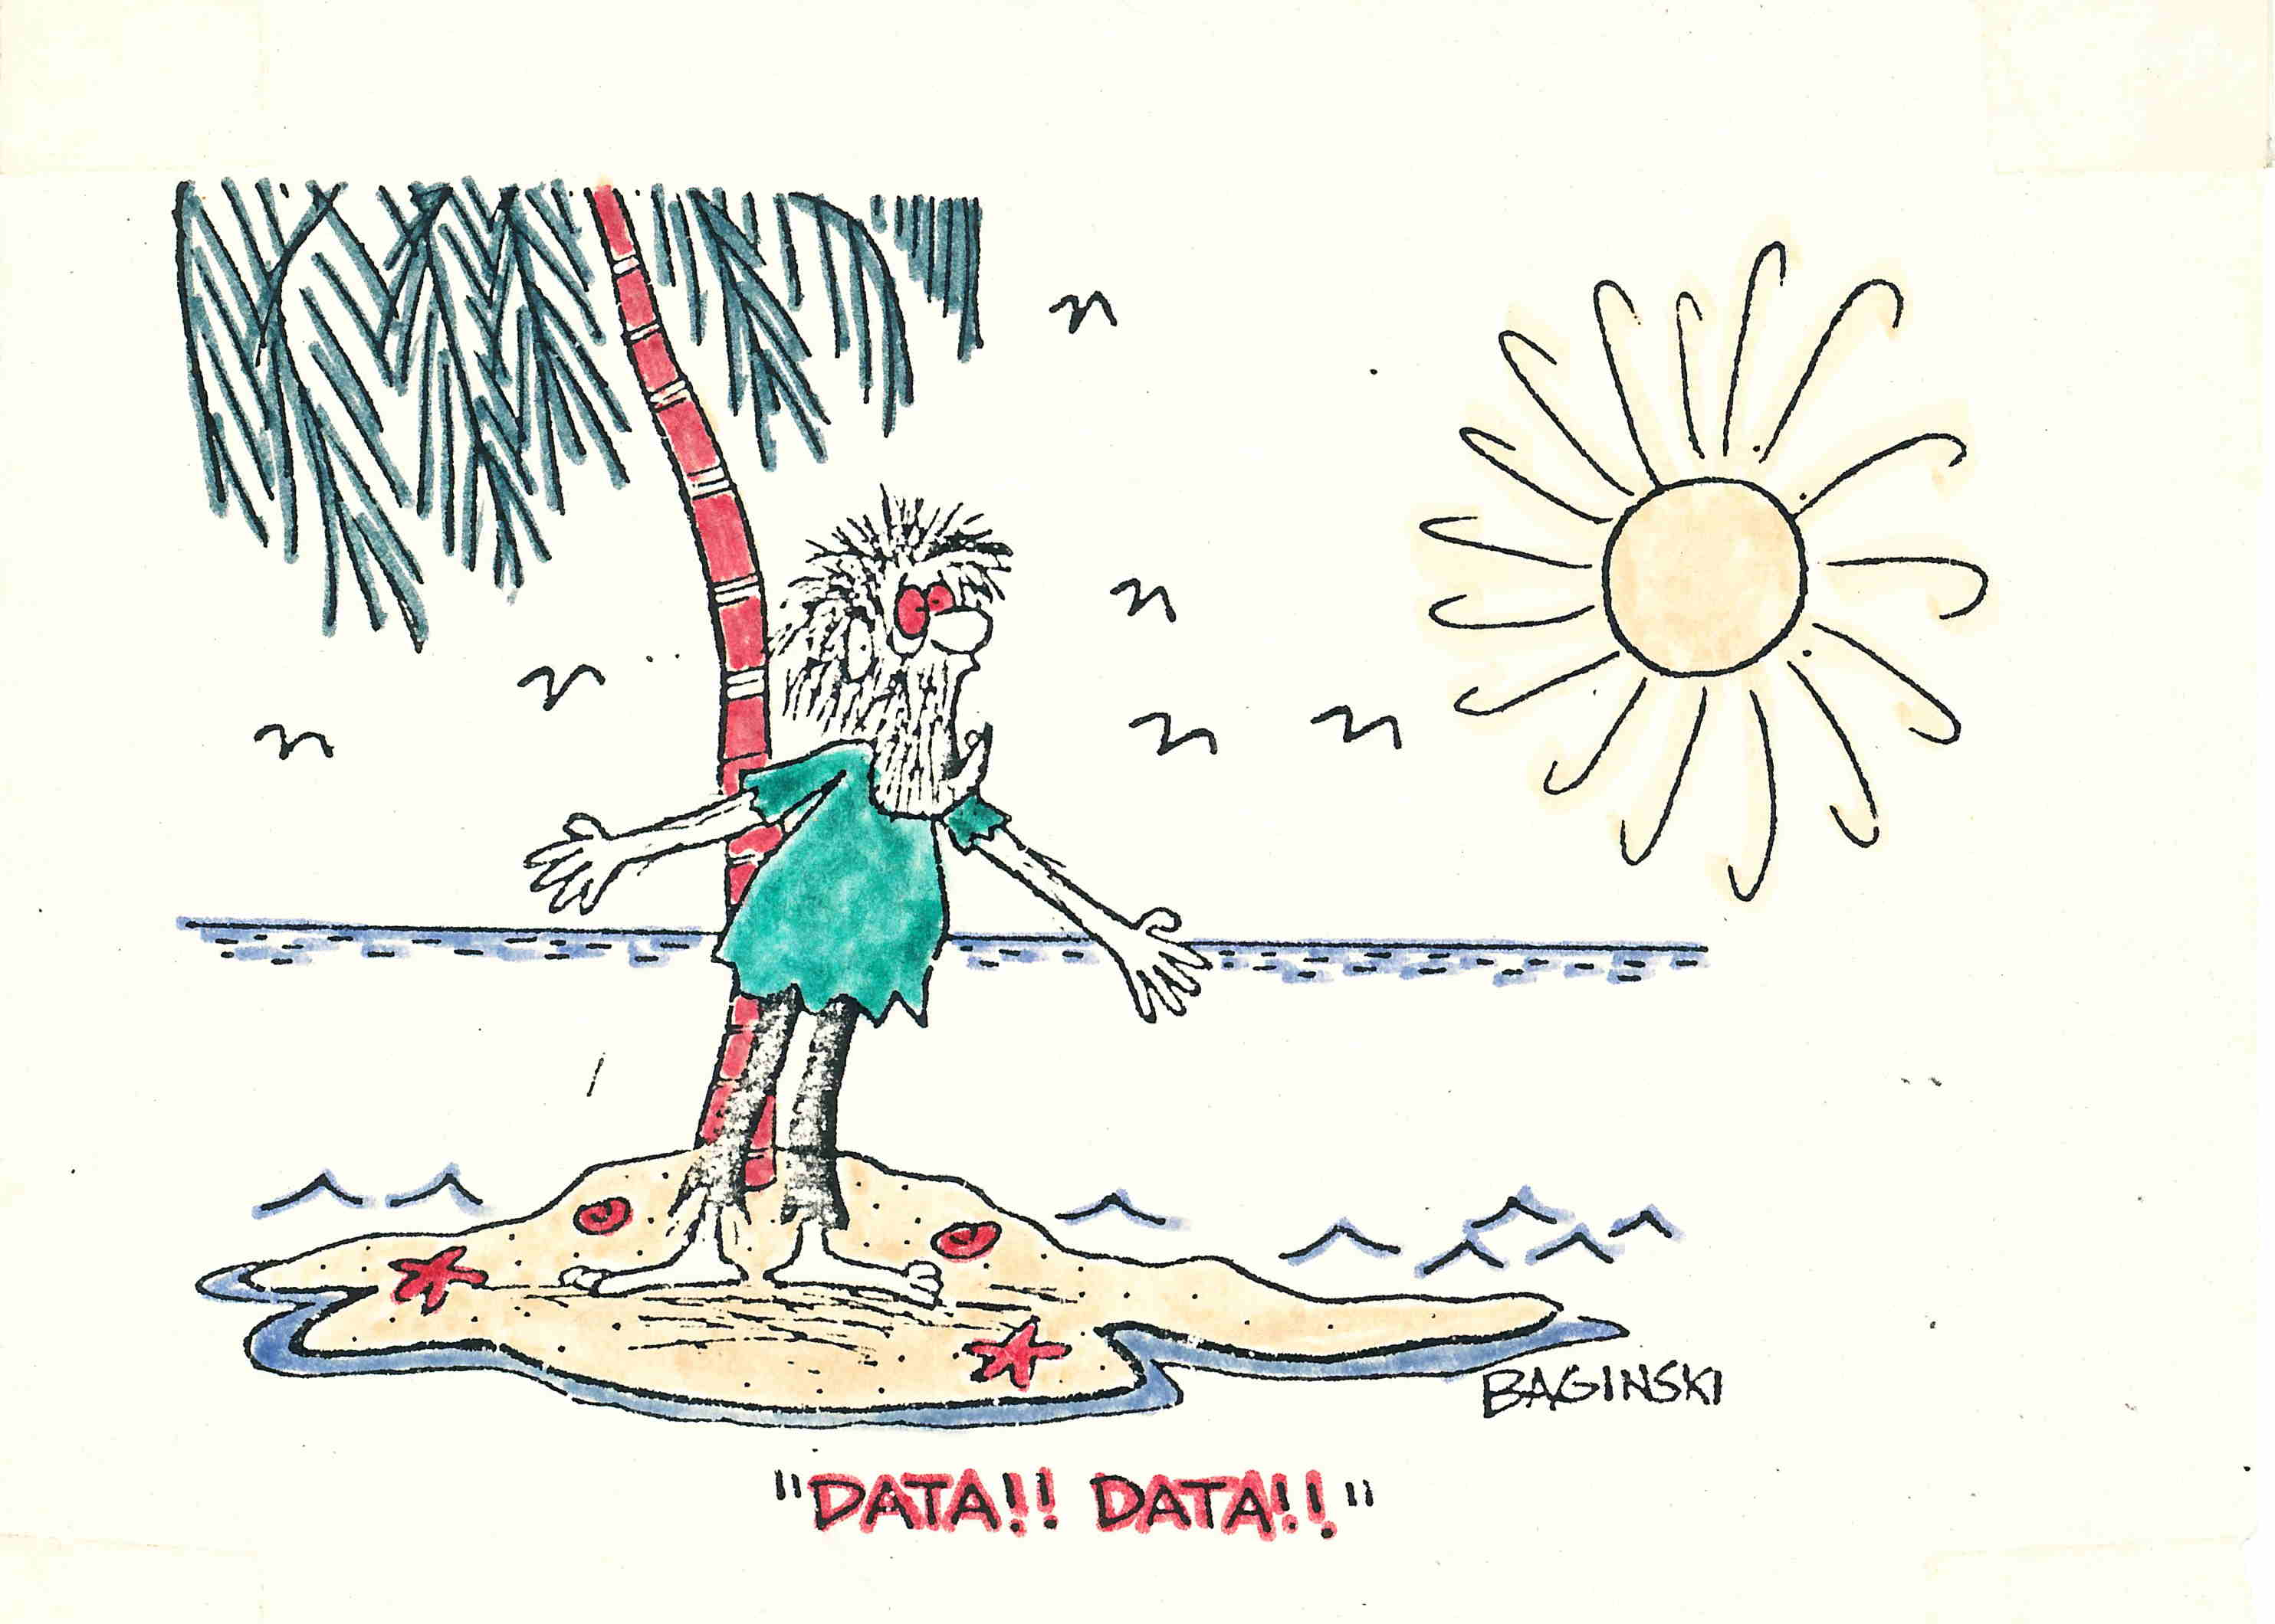
Value of Information, or
Control to Reduce Uncertainty
14

Slide 15
Conclusions
BBN tool extends our possibilities, however the thinking you still have to do yourself!
We did not explore yet all of the available features, and there are variants such as DUT UniNet. So, try it out!
Various kinds of distributions of data and models can be facilitated. Main problem remains lack of validated data.
QRA, uncertainty analysis, and decision support tools are the future in the framework of Risk Management, but need further development!

Slide 16
Increase in risk aversion
U
d²U/dY² = U”< 0
Yield = (Returns - AccRisk)
Stochastic variable

