Slide 1
Simulation of High Pressure
Liquid Hydrogen Releases
W. G. Houf and W. S. Winters
Sandia National Laboratories
Livermore, CA USA
4th International Conference on Hydrogen Safety San Francisco, CA September 12-14, 2011
Sandia is a multiprogram laboratory operated by Sandia Corporation, a Lockheed Martin Company, for the United States Department of Energy under contract DE-AC04-94AL85000.

Slide 2
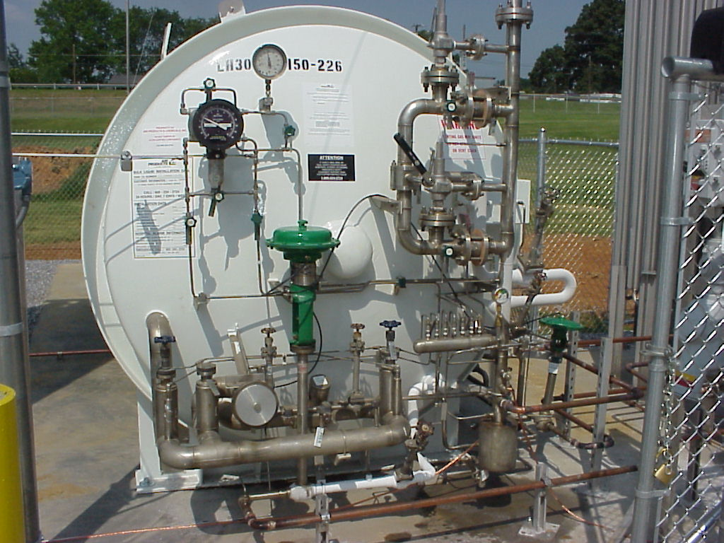
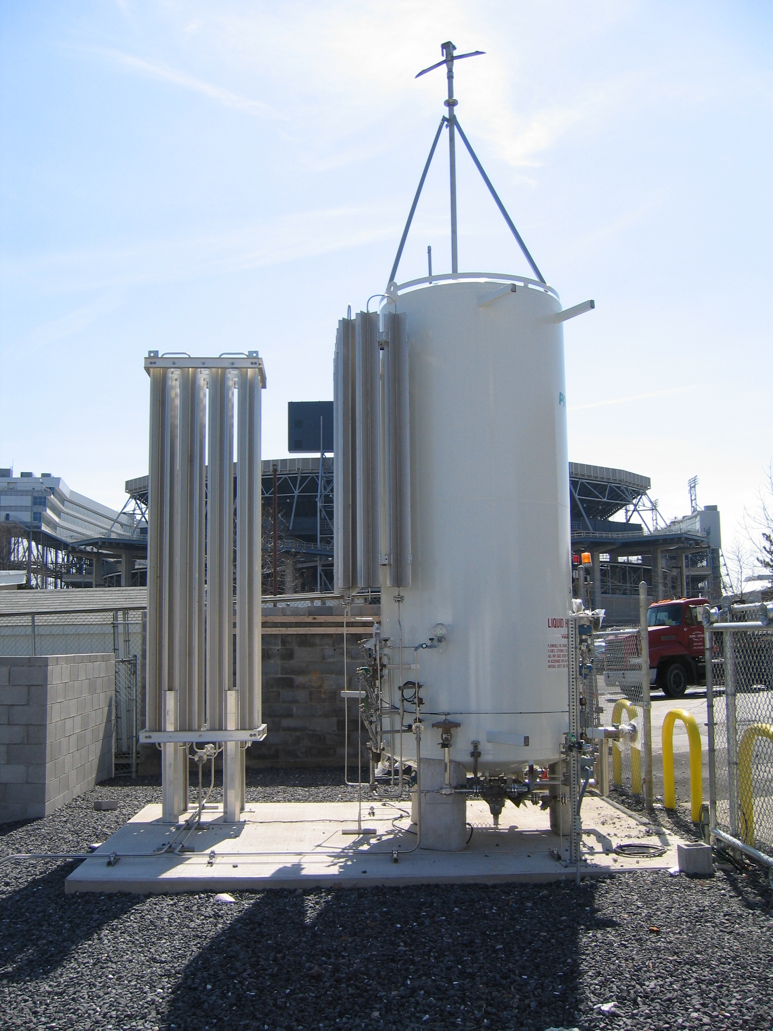
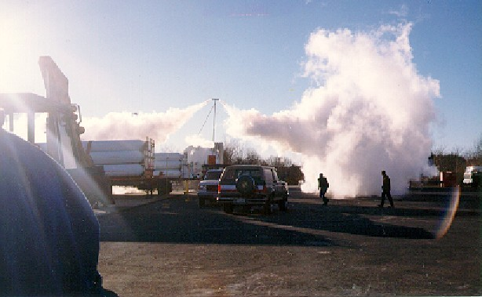
Based on feedback from industry, Sandia is focusing on “most likely LH2 releases.”
Small leaks from fittings
Planned and unplanned releases from the saturated vapor space via vertical vent stacks.
Planned releases during liquid H2 delivery operations
Unplanned releases from PRD and burst disk.
Large scale liquid spills due to “catastrophic” containment failure are being not considered.
Site Visits & Feedback
White Sands
Stennis Space Center
Kennedy Space Center
Air Products
Linde
Sandia supports the development of Codes & Standards for commercial hydrogen use.
LH2 release from vent stack.

Slide 3
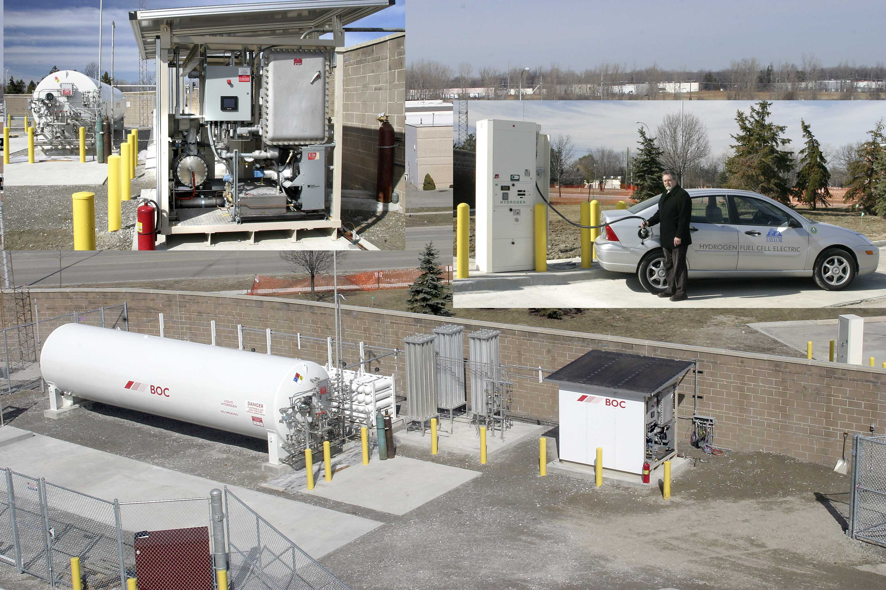
Here we focus on small scale unintended releases of LH2.
Goal: Develop model for LH2 leaks and apply to compute jet concentration decay distance to LFL of hydrogen (4% by volume)
Our models predict trajectories and dilution distances for small scale LH2 leaks.
Leaks through fittings, seals and cracks.
Previous work considered large pressure drop leaks (stream exits at atmospheric pressure)
New model improvements incorporated to compute high-momentum choked flow leaks
Leaks from saturated vapor and saturated liquid spaces considered

Slide 4
The model utilizes hydrogen and air thermodynamic models developed by NIST.
NIST equation-of-state and property relationships are incorporated into our models using Fortran callable subroutines (REFPROP Package)
Multi-phase H₂ and H₂/air mixtures are assumed to be in thermodynamic equilibrium.
We have utilized REFPROP for modeling small scale releases:
Model to predict discharge states of H₂ leaking from saturated liquid and saturated vapor spaces
Model to predict the state of the hydrogen/air mixture as it exits a “zone of initial entrainment and heating”

Slide 5
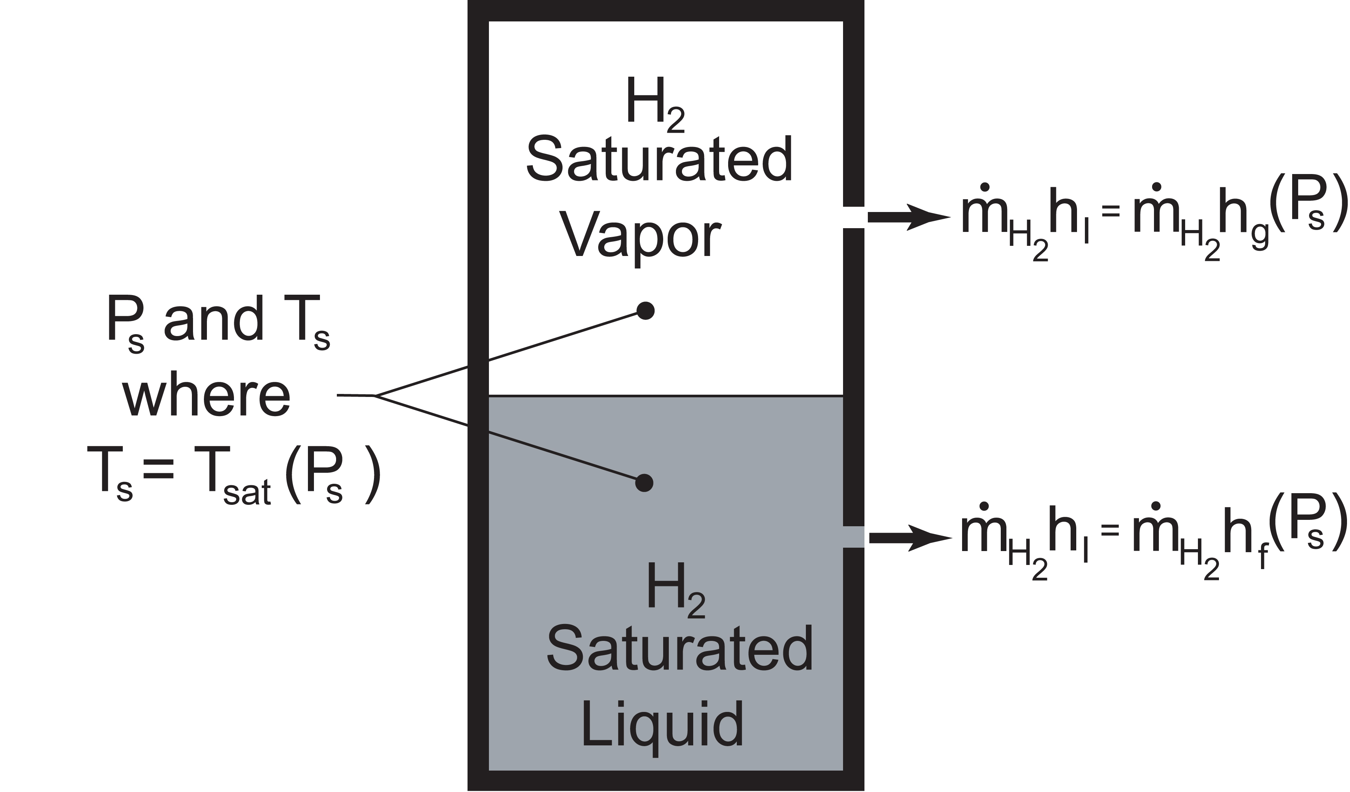
Model to predict H₂ discharge states from a leak in a LH2 storage vessel.
Assumptions for Discharge Model
Algorithm to Determine Leak Exit Conditions
Leaks are steady
Leaks occur through round holes (conservative)
Potential energy change and heat transfer small on accelerating stream (isentropic acceleration)
H₂ phases in thermodynamic equilibrium – NIST models used
Leaks can occur for LH2 saturated liquid and vapor spaces (subcooled liquid and superheated gas initial states can also be modeled)
REFPROP used to calculate sound speed (C₁)
if single-phase. Method of Chung et al.* used for two-phase (liquid and vapor)
Leak Exit Plane
(State 1)
P₁ and T₁
h₁+1/2V₁² = h₀
S₁ = S₀
P_{o} and T_{o}
(State 0)
* M.S. Chung, S.B. Park, H.K. Lee, “ Sound Speed Criterion for Two-Phase Critical Flow,”
Jour. of Sound and Vibrations, Vol. 276, pp. 13-26, 2004.

Slide 6
Overview of model for cold H₂ jets.
Features & Assumptions
• Three zone model
• Zone 1 – Under expanded flow Notional Nozzle model of Xiao et al. (P₂ = P_{atm}) if flow choked
if unchoked flow (P₁ = P₂ = P_{atm} , Station 2 Prop. = Station 1 Prop.)
• Zone 2 – Initial entrainment and heating to T₃ = 47 K (Plug flow – NIST REFPROP H₂ Prop.)
• Zone 3 – Transition from plug to Gaussian radial profile
• Zone 4 – Fully established flow (largest zone)
• Zones 3 & 4: H₂/air mixture is ideal gas and gravity is included.
• Entrainment rate model for ambient jets is used (Houf-Schefer Sandia model)*
• Upstream of Station 3 Properties from NIST REFPROP
• Downstream of Station 3 mixture of ideal gases (Atm. Pressure)
Ideal Gas
Ideal Gas
REFPROP
Leak H₂ exit state (Station 1) determined from steady state discharge model.
* Model validated against experimental data for ambient temperature jets.
Not to scale – longest zone

Slide 7
Buoyant jet model for zones 3 and 4.
Coordinate system for buoyant H₂ jet model
• Based on integral jet model in streamline coordinates
• Continuity
• Horizontal Momentum
• Vertical Momentum
• Concentration
• Energy
• Trajectory
• Profiles of jet velocity and scalars assumed
Gaussian in zone of established flow
(for example)

Slide 8
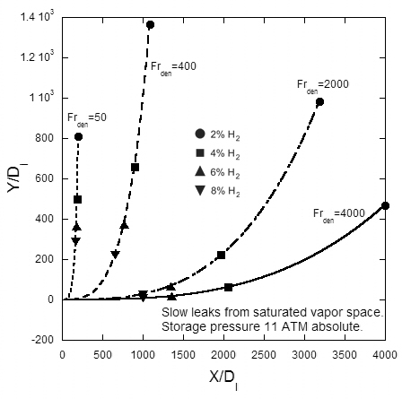
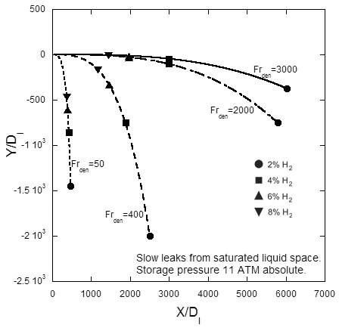
Trajectories and concentration decay for large pressure drop slow leaks have been computed with the model at 1.11 MPa (11 atm*) absolute storage pressure.
Vapor Leaks
Liquid Leaks
For a given storage pressure and leak location (vapor/liquid) slow leaks are characterized by the densimetric Froude number.
* Typical in the industry

Slide 9
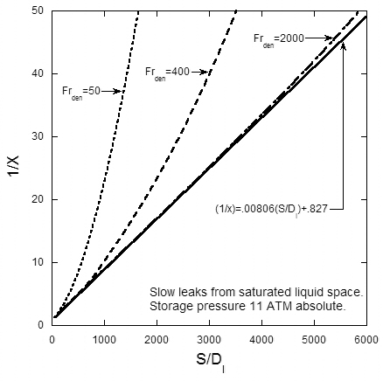
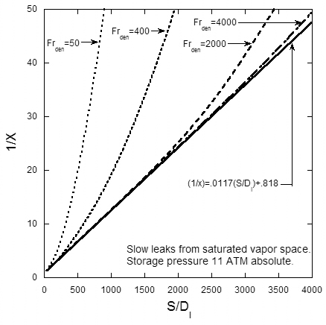
Simple expressions can be used to predict hydrogen dilution for high Froude number leaks*.
Vapor Leaks
Liquid Leaks
* Leaks from 1.11 MPa (11 atm) absolute systems

Slide 10
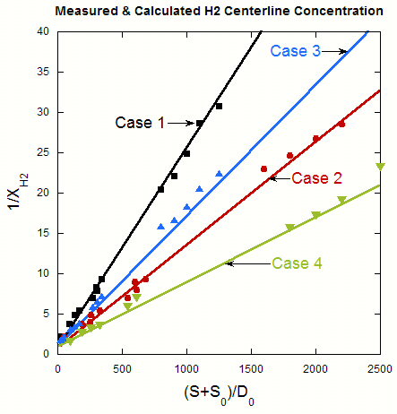
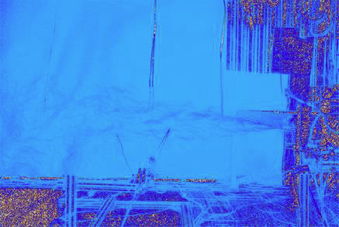
The jet model has been validated with high-momentum H₂ jet release data from K.I.T. (FZK).
• Model in good agreement with experimental data
• Data from K.I.T. (FZK) experiments (Xiao et. al.)¹
• Data in choked-flow high-momentum regime
• Additional data needed for lower temperature
behavior validation (< 80 K)
Reservoir conditions and leak diameters for
K.I.T. (FZK) experiments (Xiao et al.*)
Unignited H₂ Jet Image (BOS) from
K.I.T. (FZK) Experiments
• Virtual jet origin calculated using Yuceil and Otugen²
source model.
1. J. Xiao, J. R. Travis and W. Breitung, “Hydrogen Release from a High-Pressure GH2
Reservoir in Case of a Small Leak,” 3rd ICHS International Conference on Hydrogen Safety,
Ajaccio-Corse, France, September 16-18, 2009.
2. K. B. Yuceil and M. V. Otugen, “Scaling Parameters for Underexpanded Supersonic Jets,”
Physics of Fluids, Vol. 4, No. 12, pp. 4206-4215, December, 2002.

Slide 11
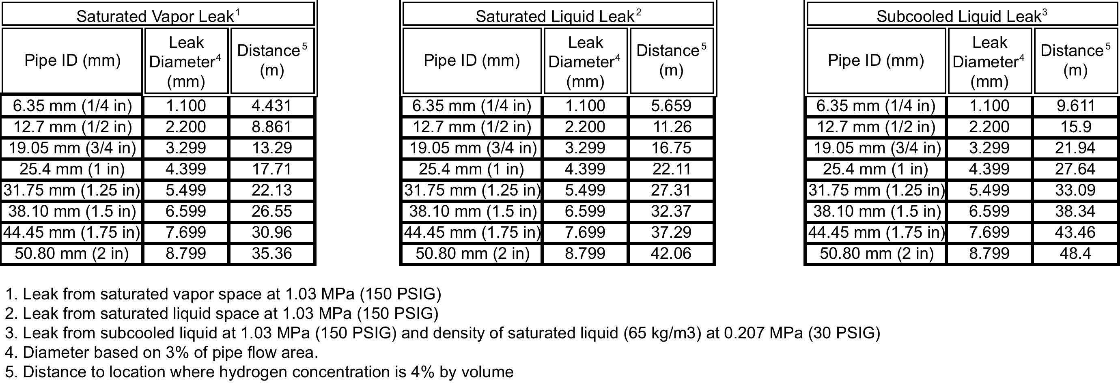
We have computed a set of concentration decay distances to LFL (4% m.f.) for high-momentum choked flow leaks from a LH2 storage space.
• Calculations performed as part of work with NFPA 2 Task Group 6
• Liquid H2 storage pressure 1.03 MPa (150 psi) gage
• Leaks assumed to be from 3 different storage locations:
Saturated Vapor storage space
Saturated Liquid storage space
Sub-cooled liquid storage space
• 3% flow area leaks* assumed to come from pipe I.D.s - 6.35mm (1/4 inch) to 50.8mm (2 in)
Distance to 4% H₂ Mole Fraction Concentration
* Based on gaseous H₂ separation distance work performed by NFPA 2 Task Group 6 (LaChance et al.)
J. LaChance, W. Houf, B. Middleton, L. Fluer, “Analysis to Support Development of Risk-Informed
Separation Distances for Hydrogen Codes and Standards,” Sandia Report SAND2009-0874, March 2009.

Slide 12
Summary and Conclusions
• Turbulent buoyant jet model has been developed to predict trajectories and concentration
decay distances for choked and unchoked LH2 leaks.
• NIST thermodynamic models have been used to determine multi-phase H₂ states and low
temperature H₂/air states.
• The model has been experimentally validated for 298K H₂ and 80K high-pressure H₂ jets
(more experiments are needed).
• Simulations performed 3 types of multi-phase leaks from LH2 storage space
• Saturated vapor leaks LH2 showed the shortest decay distance to LFL (4% m.f.)
• LFL decay distance for leaks from saturated liquid space approx. 19-28% longer than
corresponding leaks from saturated vapor space
• Largest LFL decay distances computed for subcooled liquid leaks (approx. 37-117% longer
than corresponding saturated vapor leaks)
• Saturated liquid and subcooled liquid leaks enter atmosphere as two-phase mixtures
having qualities (denser hydrogen) than saturated vapor leaks and longer distances are
required to entrain enough air to dilute these leaks
• Saturated liquid and subcooled liquid leaks were negatively buoyant in air while saturated
vapor leaks were positively buoyant
• All leaks were high-momentum choked flow leaks with trajectory to LFL not greatly
influenced by buoyancy

Slide 13
Extra Slides

Slide 14
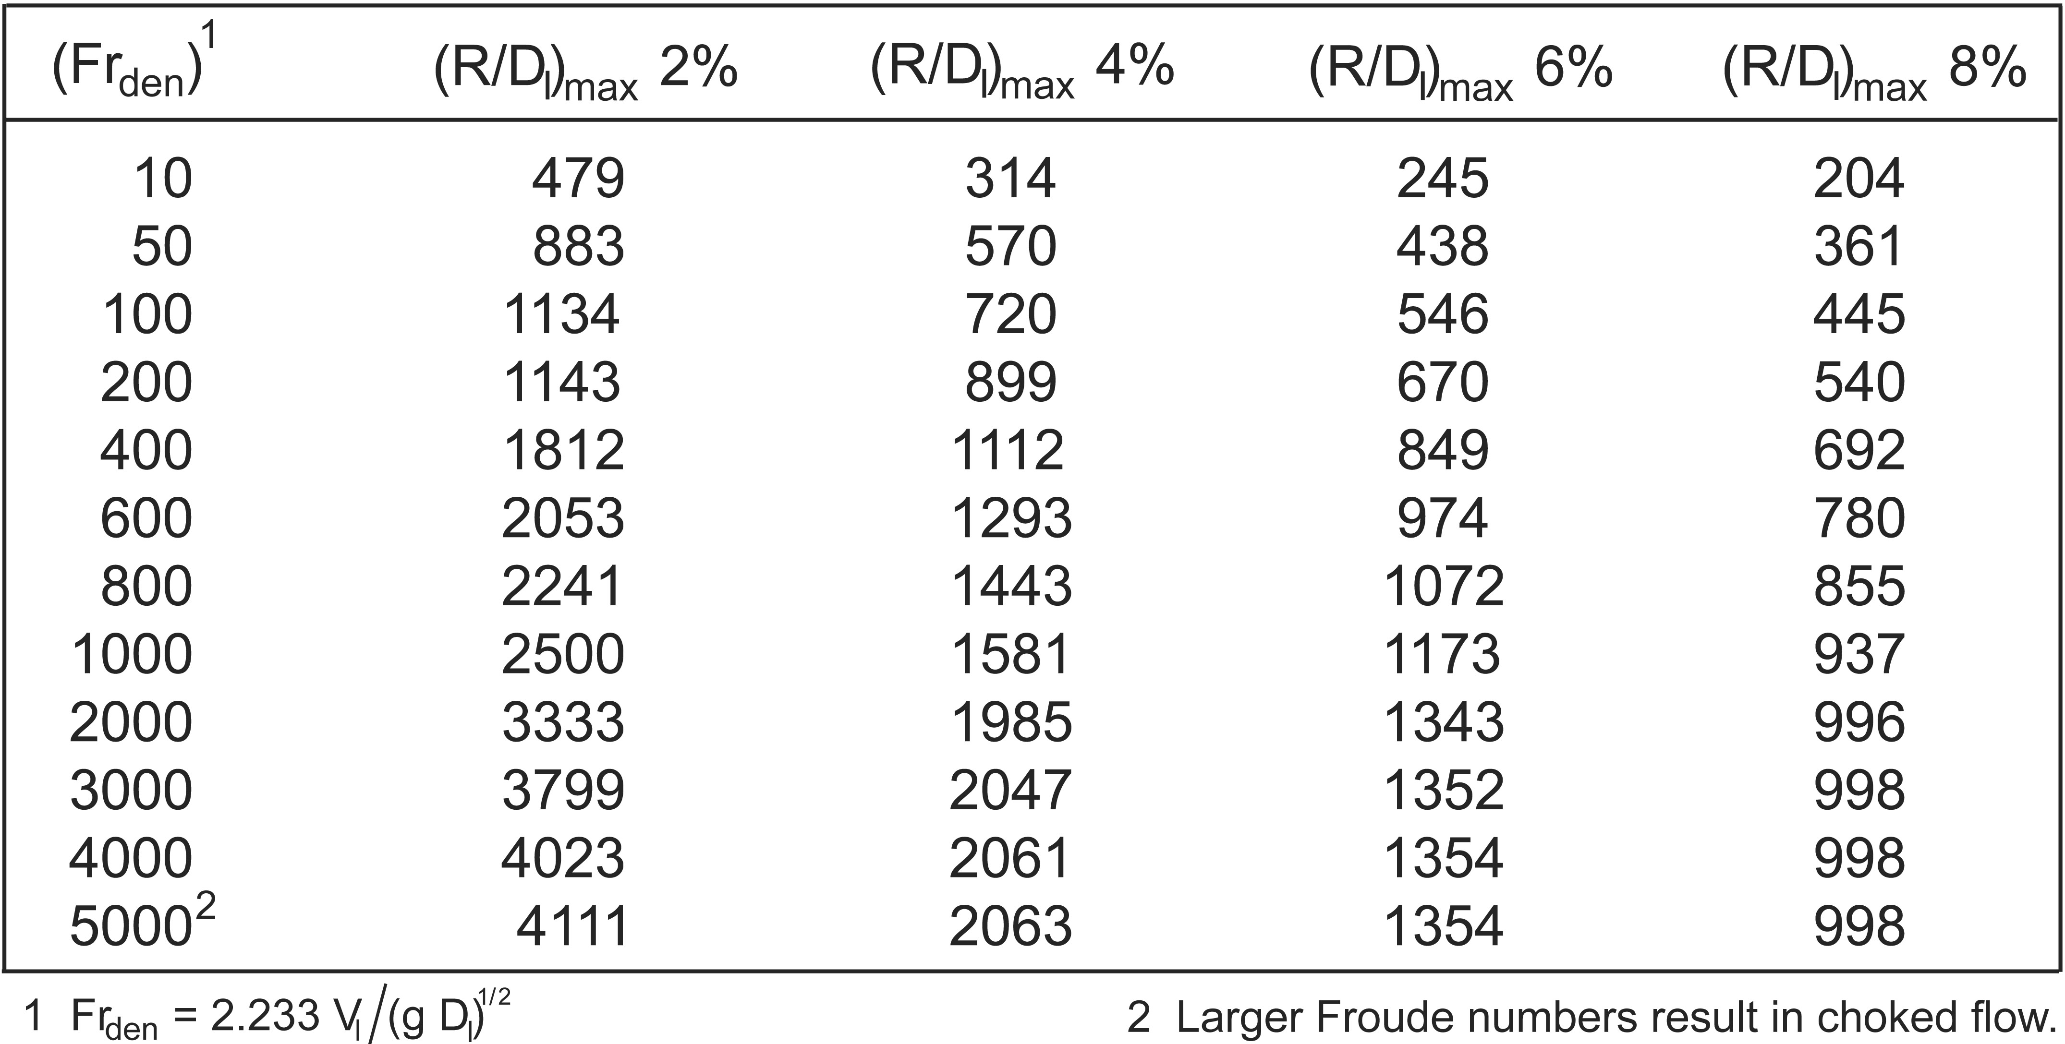
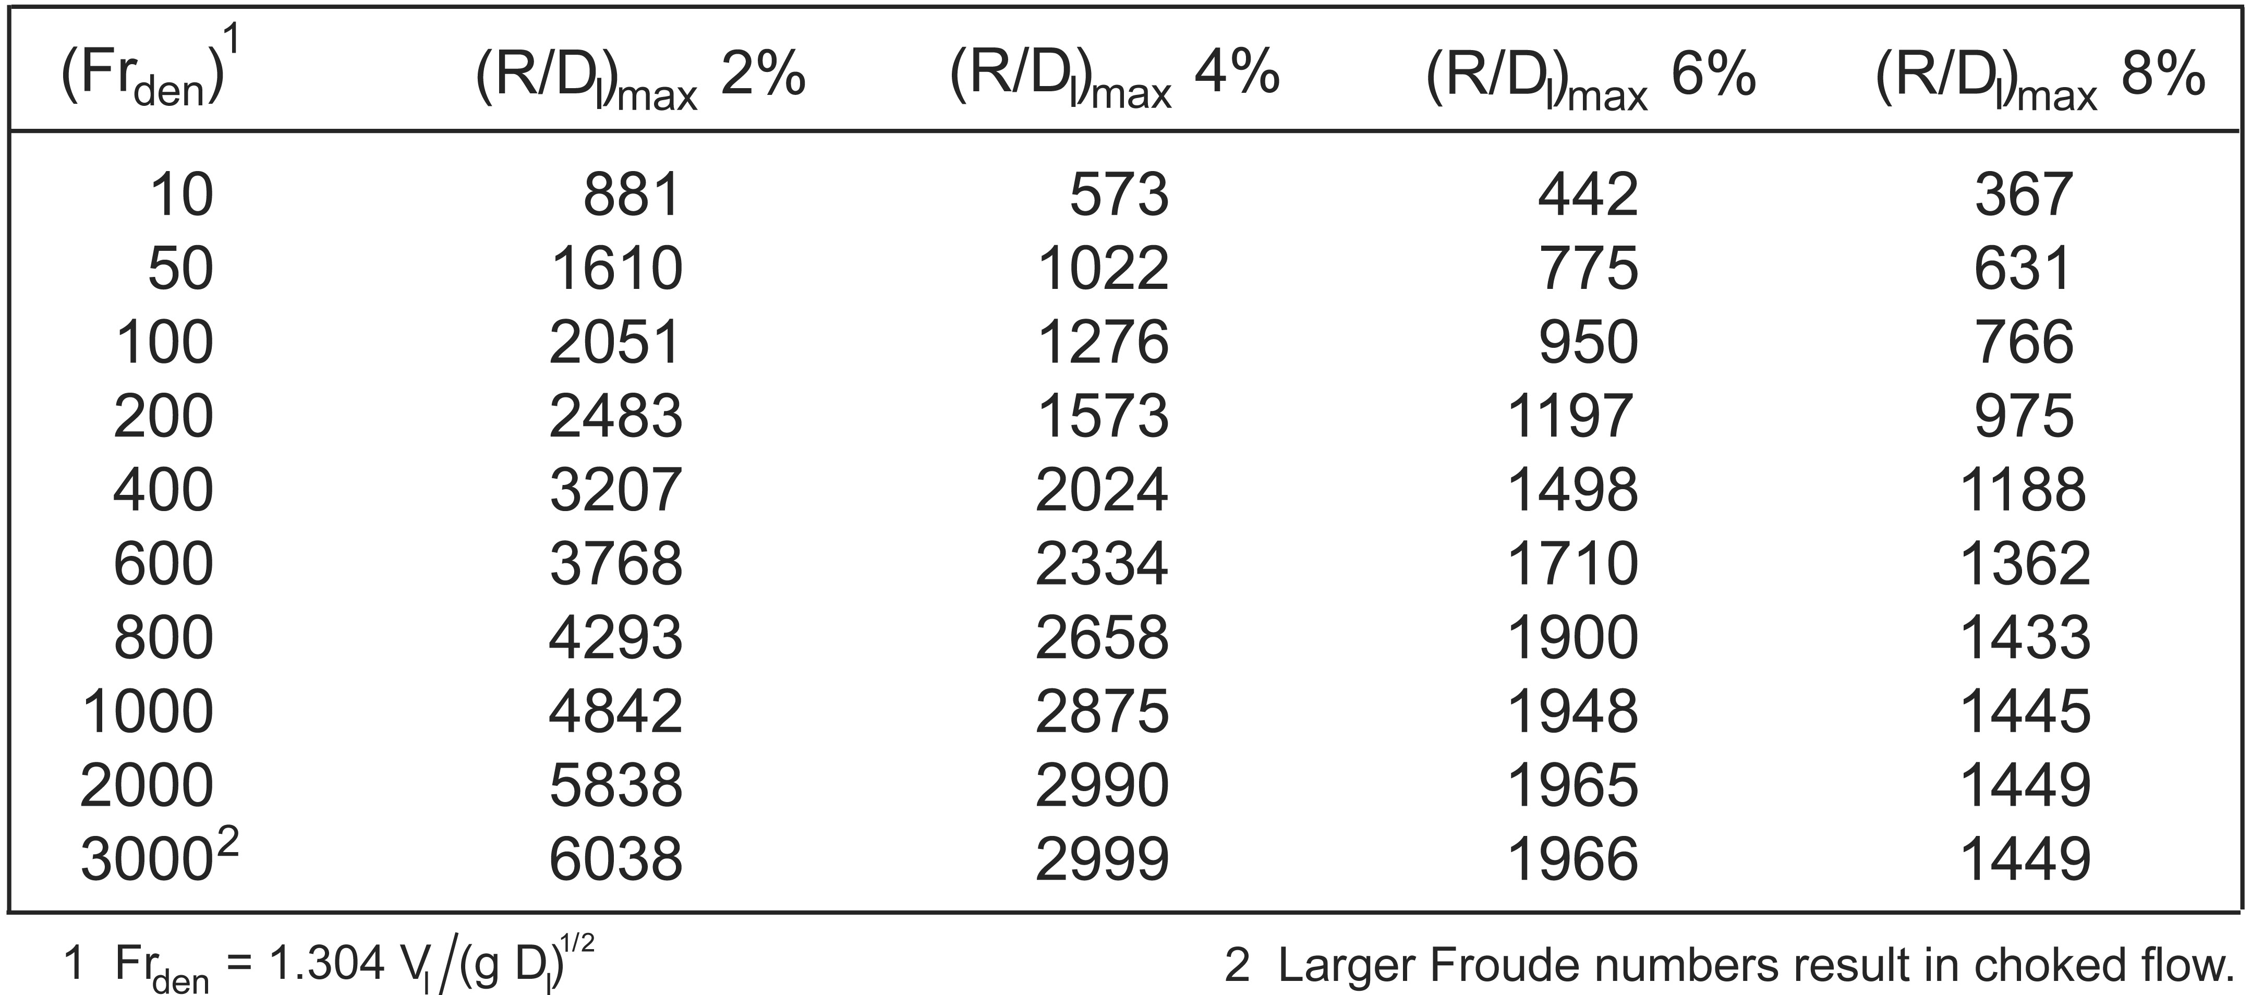
We have developed tables showing concentration envelopes
for small scale leaks from 11 atm systems.
Vapor Leaks
Our results show that LH2 leak dilution distances are approximately four (vapor) to seven (liquid) times greater than ambient temperature H2 leaks.
Liquid Leaks

