Slide 1
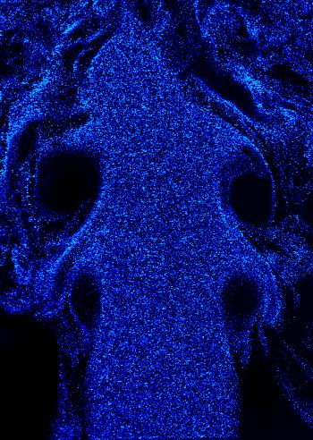
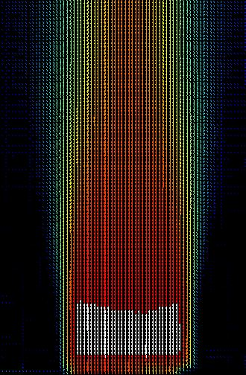
QUANTITATIVE IMAGING OF MULTI-COMPONENT TURBULENT JETS
Arash Ash
Supervisors:
Dr. Djilali
Dr. Oshkai
Institute for Integrated Energy Systems
University of Victoria
ICHS2011 – September 12th 2011

Slide 2
Safety Standards
The integration of a hydrogen gas storage has not been without its challenges.
Flammable characteristics of Hydrogen results in the requirement of more robust, high pressure storage systems that can meet modern safety standards.
Prior to the development of a hydrogen infrastructure, well-researched safety standards must be implemented to reduce the risk of uncontrolled leaks related to hydrogen storage.

Slide 3
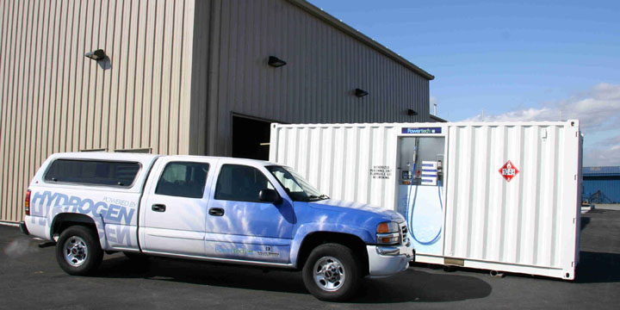
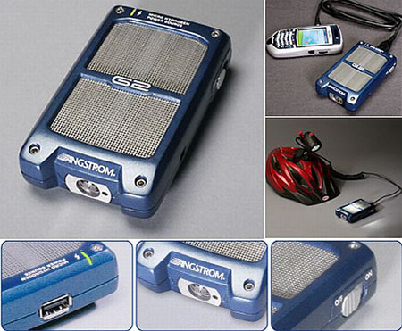
H2 – Fuel Cell Application
Notes:
Hydrogen storage system are used in broad range of applications and pressures.
The pressure in the hydrogen storage systems ranges from several bars to several hundred bars.

Slide 4
Project Motivation and Objectives
Perform series of well-defined experiments to generate data to guide development of engineering turbulence model suitable for rapid discharge simulations
Objectives
experimentally characterize the effects of buoyancy and cross-flow in a complex flow structure
provide a quantitative database that can be used for future concentration measurements and also to validate CFD models
Notes:
This work is part of the collaboration between university of Victoria and “Université du Québec à Trois-Rivières“ to Perform series of well-defined experiments to generate data to guide development of engineering turbulence model suitable for rapid discharge simulations
this study focuses on subsonic release of hydrogen using helium as a substitute working fluid. And emulates the leak of gas from a compressed hydrogen tank taking presence of a crossflow, a possible scenario for fuel cell and hydrogen stations.
4. The mean and fluctuation velocity components were well quantified using Particle Imaging Velocimetry (PIV) to show the effect of buoyancy and cross-flow to provide a database that can be used for future concentration measurements and to validate CFD models.

Slide 5
Introduction
the momentum and buoyancy effects related to the rapid, uncontrolled release of hydrogen must be studied in detail to accurately determine the resultant dispersion.
In this study, dispersion of a buoyant, turbulent, round jet in a quiescent and moving ambient at a wide range of Froude numbers was investigated.
This study focuses on slow leaks which might take place in small-scaled hydrogen based systems.
Notes:
1. This work focuses on small leaks which may take place in various small-scaled hydrogen based systems with leaky fittings and O-rings seals or in low pressure electrolysers as well as in vents in hydrogen storage facilities
2. This buoyant jet discharge flow configuration becomes more complicated by introducing a moving ambient. Among these flow configurations, the cross-flowing turbulent jet, in which a round jet is injected into a perpendicular fluid stream, is of particular interest, as it is representative, for instance, of the dispersion of hydrogen in a windy environment.

Slide 6
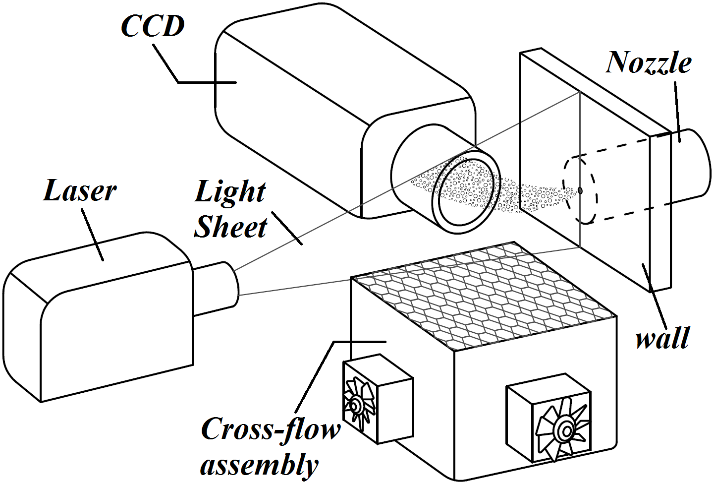
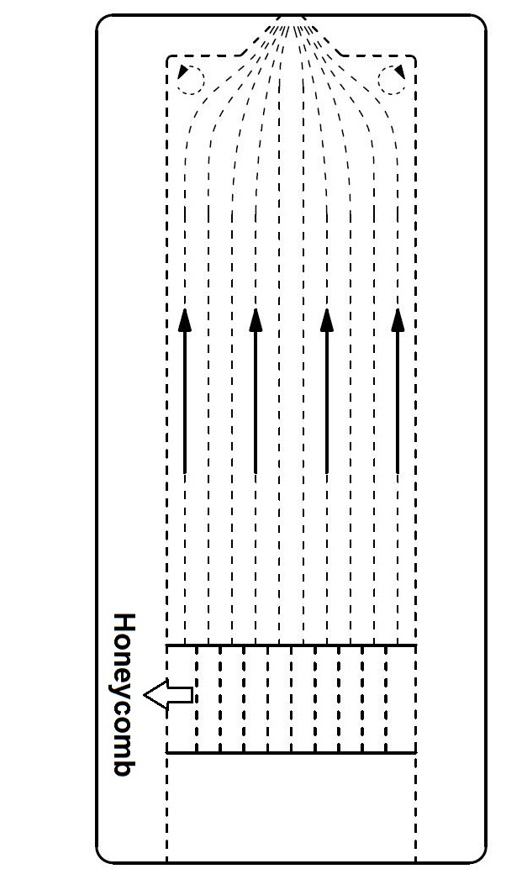
Experimental Setup
Jet Apparatus:
honeycomb settling chamber
Sharp-edged orifice
Nozzle Diameter = 2mm
Cross-flow assembly:
11m/s ± 4%
Laser: Nd YAG 532 nm
CCD camera: 1376 × 1040 pixels
Notes:
Experimental setup in this experiment consists of a jet system which has sharp-edged orifice nozzle,
It can be argued that sharp-edged orifice emulates a leak scenario more realistically however limited information about this type of nozzle is available. This inflow condition is characterized by a relatively complex initial velocity profile.
Crossflow: A blower type apparatus has been designed and manufactured with a goal of producing an adjustable uniform velocity cross flow region emulating wind. Isentropic turbulence distance after honeycomb structure was calculated to be approximately 10cm . The resultant velocity field measured to be 11 m/s with 4% variation.
Assembly: In this study jet apparatus was positioned horizontally in order to capture buoyant characteristics of the flow and the cross-flow assembly was positioned to amplify the jet flow in the direction where buoyant forces were dominant.
PIV:
Quantitative flow visualization was accomplished by employing PIV, Particle image velocimetry (PIV) is an optical method of fluid visualization that measure the motion of small, marked regions of a fluid by observing the locations of the images of the markers at two or more times.
PIV priciples:
Laser: Nd YAG laser with 532 nm wavelength which turned into a sheet by means of optics
CAMERA: a total of 1376 x 1040 pixel CCD was used to capture a 21.5 x 15 mm window with which gives a total resolution of 16pixels /μm
SHARP-EDGED ORIFICE: Briefly, in sharp-edged configuration flow undergoes a sudden contraction which causes an initial separation in the flow and increases the initial turbulence intensity (Shown in figure), and this upstream contraction causes the flow to converge downstream of the exit and expand (Vena contracta) which will lead to a local maximum in centerline velocity profile. Sharp-edged orifice leads to a faster decay and increased entrainment.
WHY HELIUM: In the present study, helium was selected as the working fluid, because it is inert and its molecular weight is very close to the molecular weight of hydrogen.

Slide 7
Flow Conditions
Case | Q (lpm – H₂) | U_{oc} (m/s) | Fr | Re | r
1 | 64.4 | 318.33 | ~1000 | 5263 | 11.2
2 | 43.4 | 248.98 | ~750 | 4196 | 6.9
3 | 35.7 | 185.23 | ~500 | 3121 | 6.1
4 | 21 | 94.56 | ~250 | 1593 | 3.2
5 | 12 | 18.86 | ~50 | 317 | 0.6
Helium density and viscosity are 0.166 kg/m³ and 1.97E-05 kg/ms, respectively
Where Fr – Froude number, Dimensionless; U_{oc} – Jet centerline exit velocity, m/s; g – acceleration due to gravity, m²/s; D – Jet diameter, mm;
, ρ∞ – Ambient air density, kg/m³ and ρ_{j} – Jet exit density of helium, kg/m³
Notes:
Flow conditions used in this study together with corresponding Froude and Reynolds number are listed in this table. The definition of the Froude number is included.
Froude number has been proved to be a good measure of ratio of momentum to buoyancy forces in subsonic discharge of flows. A wide range of Froude numbers was considered and experimental conditions were set accordingly

Slide 8
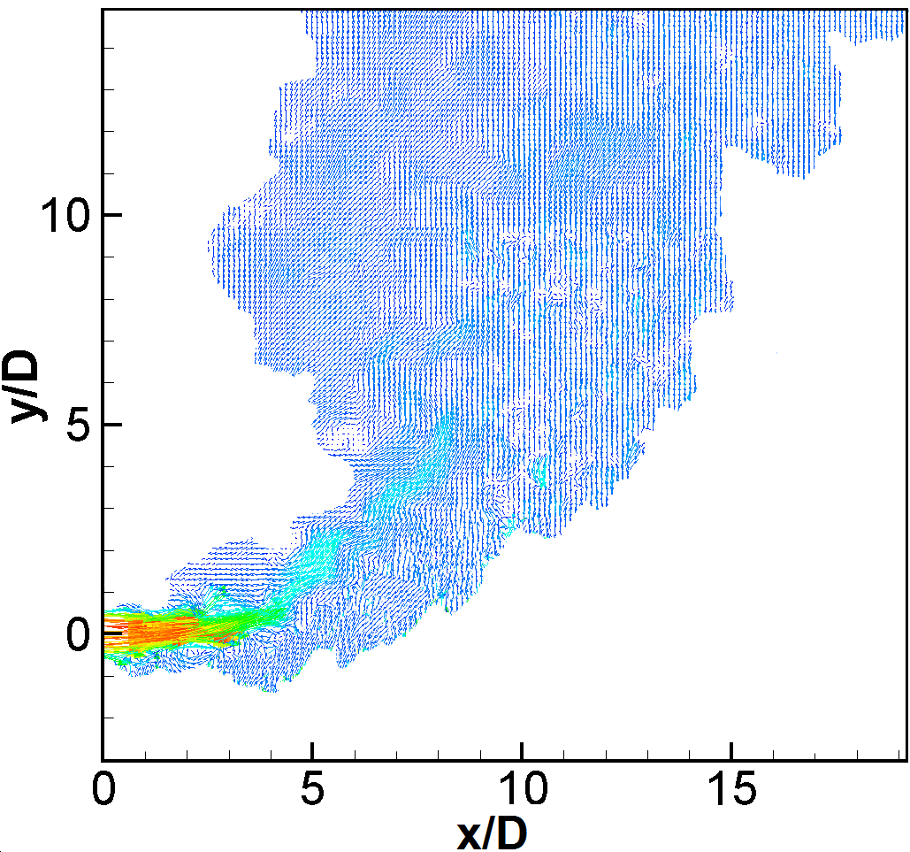
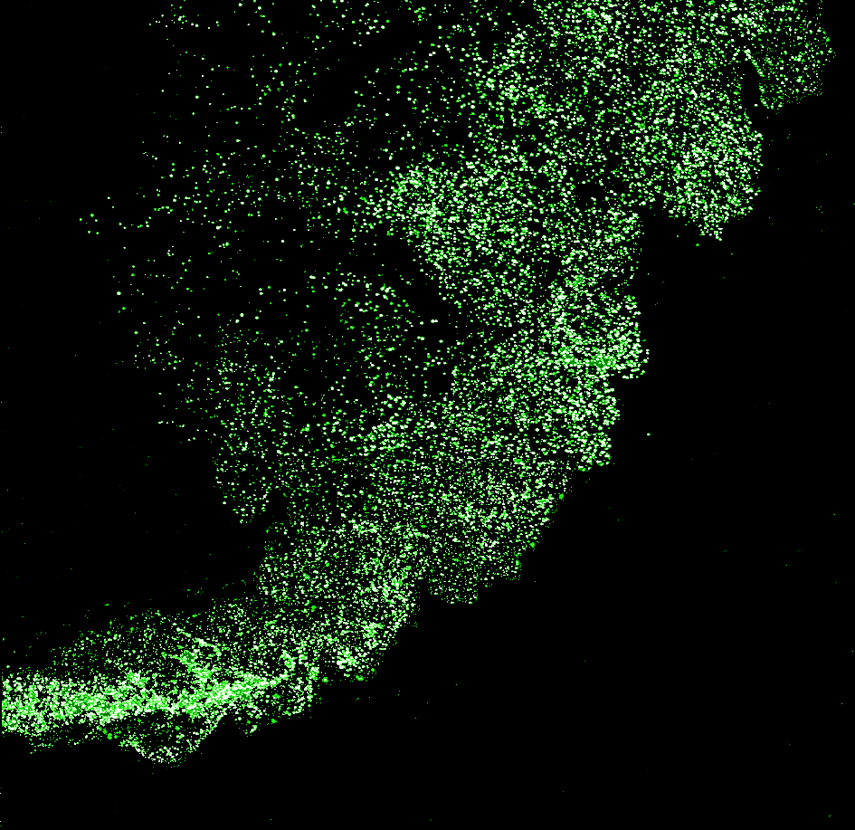
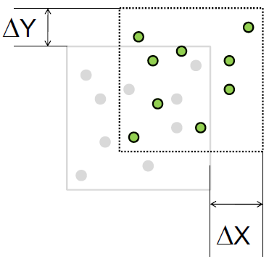
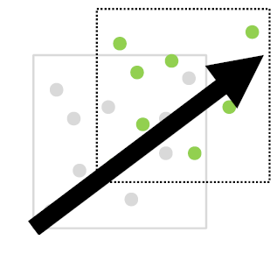
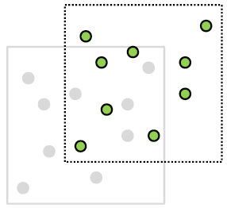
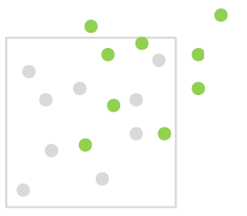
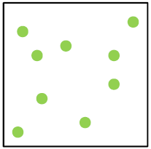
PIV - Cross Correlation
Particles In image B
Original IA
Search Area
Notes:
Seeded flow
Interrogation windows
Finger prints
Following finger prints in consequent image
Calculating velocity vectors
All particles look alike, so it is hard to find the ‘same’ particle in both Frame A and B, Instead, PIV uses a statistical approach to find the most likely displacement of a group of particles, Frame A is broken up into a grid of ‘interrogation regions’, The group of particles in the interrogation region creates a fairly unique ‘fingerprint’
A search area is defined in Frame B of PIV Image Pair
The value of the correlation function will be maximum when the ‘fingerprint’ is identified in Frame B
The X and Y displacements of the particles are determined by the offset of the interrogation regions
Since we know the time separation (Δt) between the 2 laser pulses very accurately, we can measure the group velocity

Slide 9
Results and Discussions

Slide 10
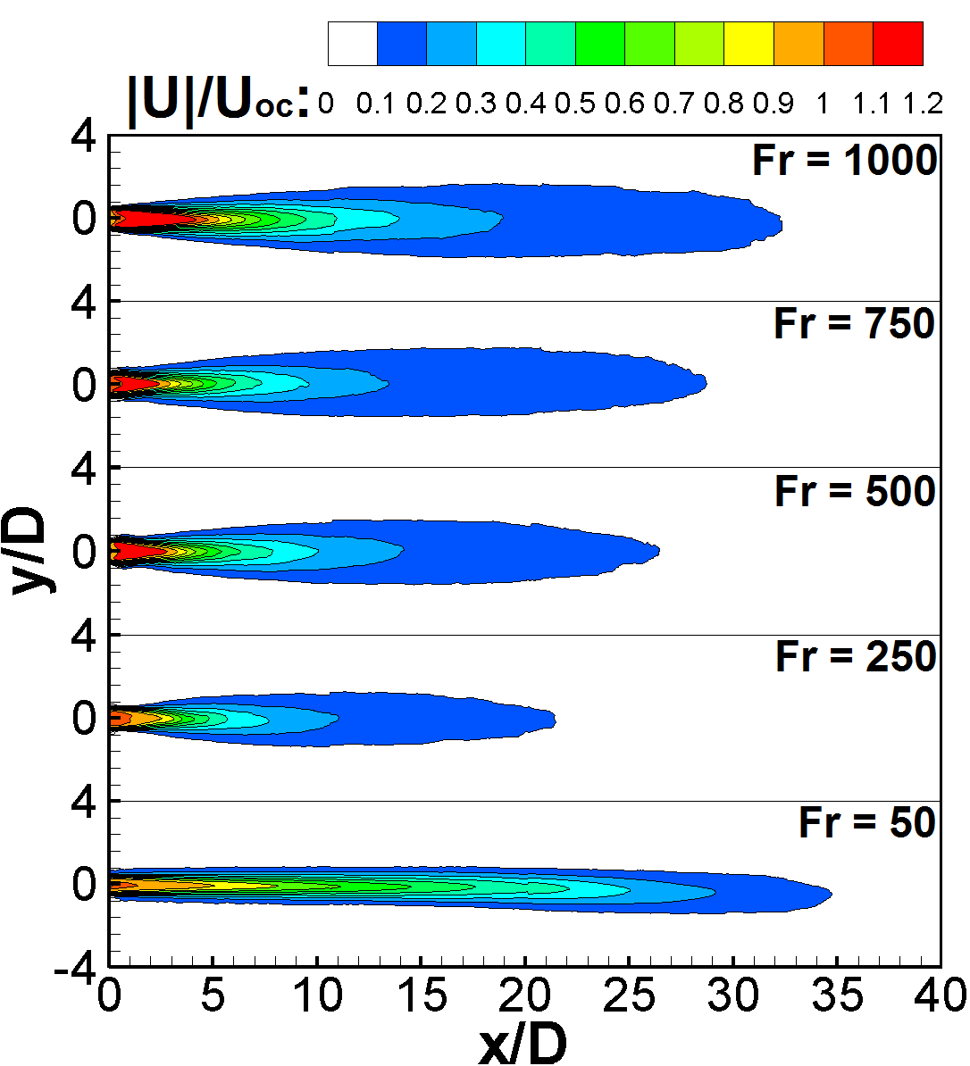
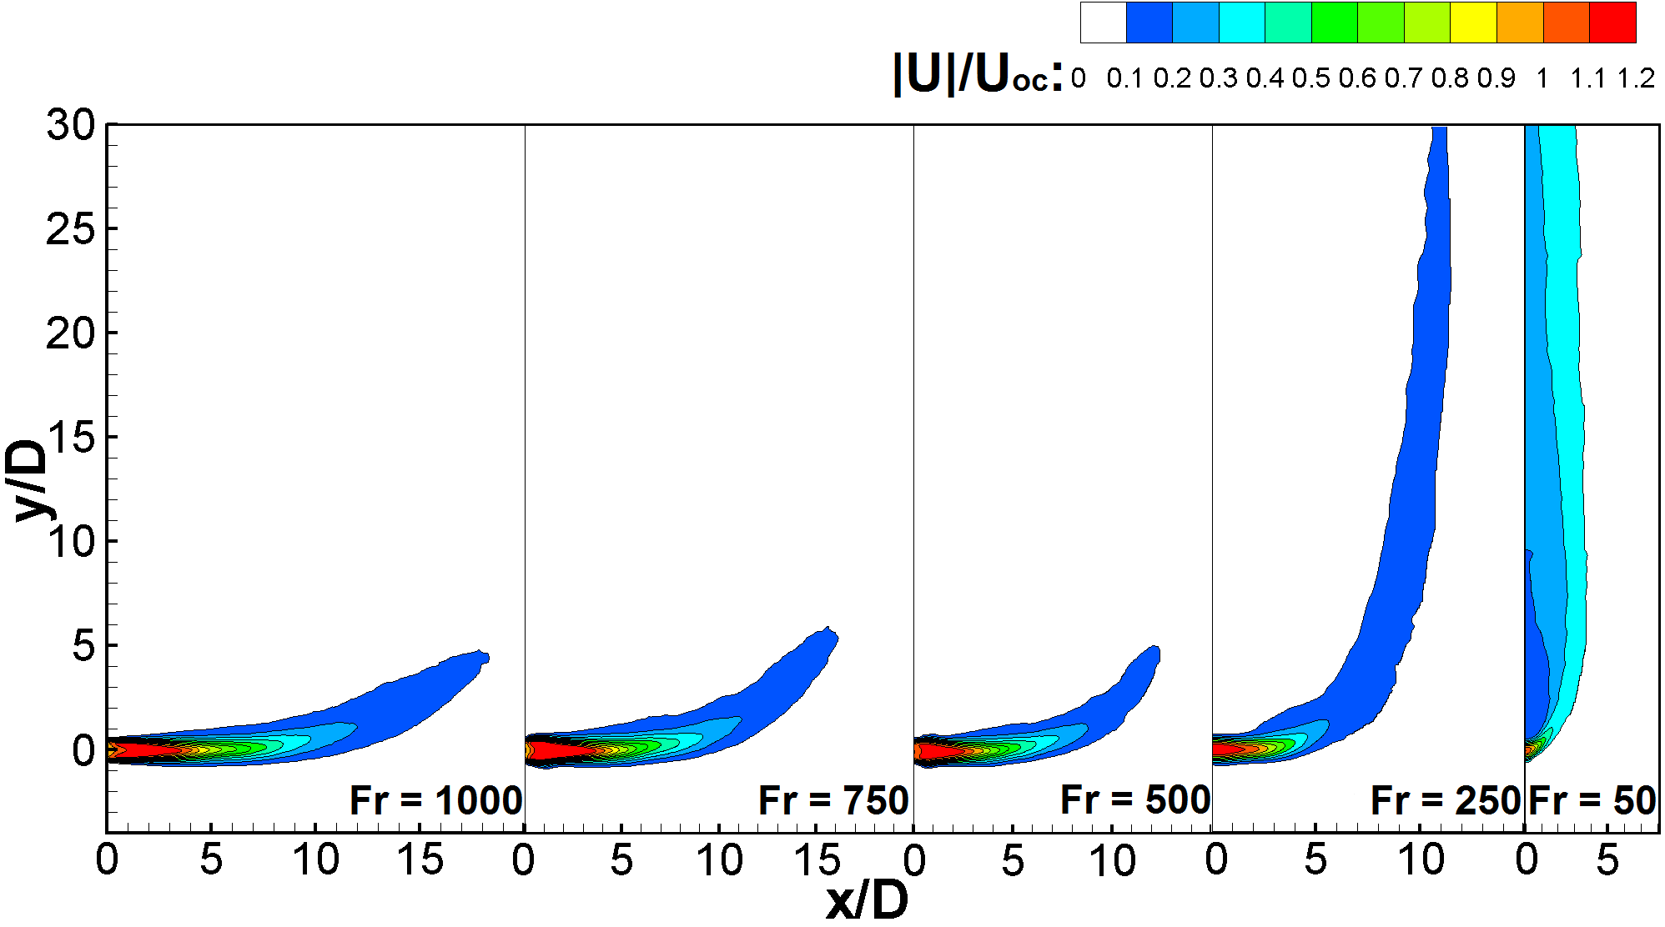
Velocity Fields
Free Jet
Jet in Cross - Flow
Notes:
Time-averaged velocity contours of free jet with different Froude numbers are shown in the figure, Velocity field was normalized by time-averaged jet exit velocity and x and y coordinate system were normalized by jet diameter, D. Dark central area corresponds to the potential core region with approximately uniform mean velocity magnitude.
Remarks: For Higher Froude numbers flow contours spread out symmetrically and effects of buoyancy forces were negligible but for Froude numbers lower than 268 the far-field region deformed under the influence of buoyancy forces.
It should be noted that for Fr = 50 the corresponding Reynolds number was calculated to be 317 which corresponds to Laminar flow and jet was observed to travel with minimal entrainment for 25D in downstream location and transitioned to turbulence in farther downstream locations.
<CLICK>
Time-averaged velocity contours for the case of jet in cross-flow is presented in this figure. Increasing Froude number jet traveled farther horizontally before turning towards the cross-flow direction because of higher initial momentum,
For case of Fr = 50 low jet to cross-flow velocity ration resulted a sudden break down of jet structure and led to appearance of plume like structure downstream of a very short momentum dominated region.

Slide 11
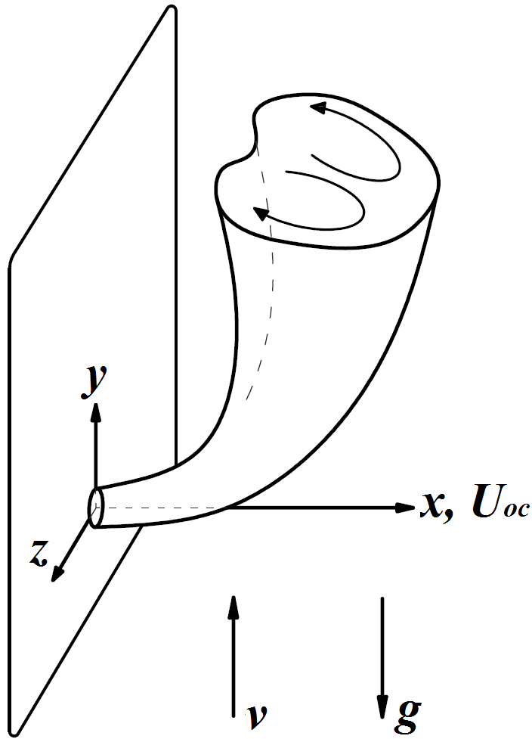
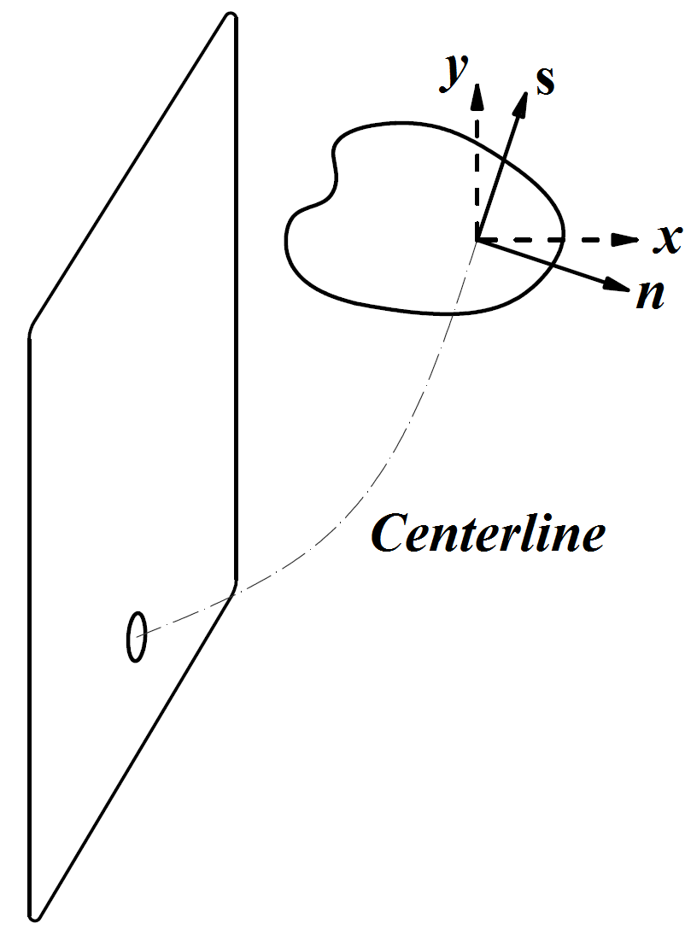
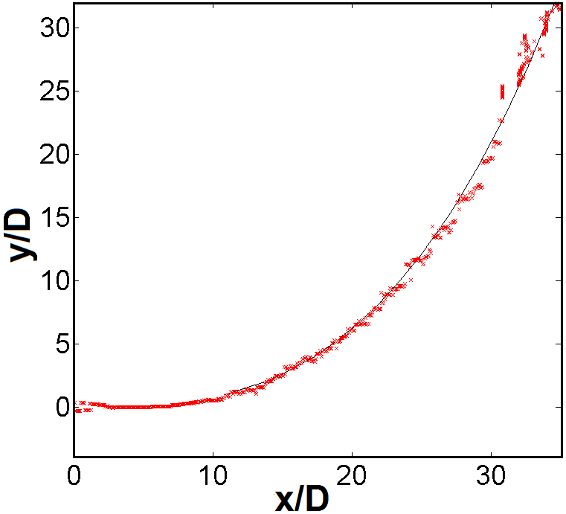
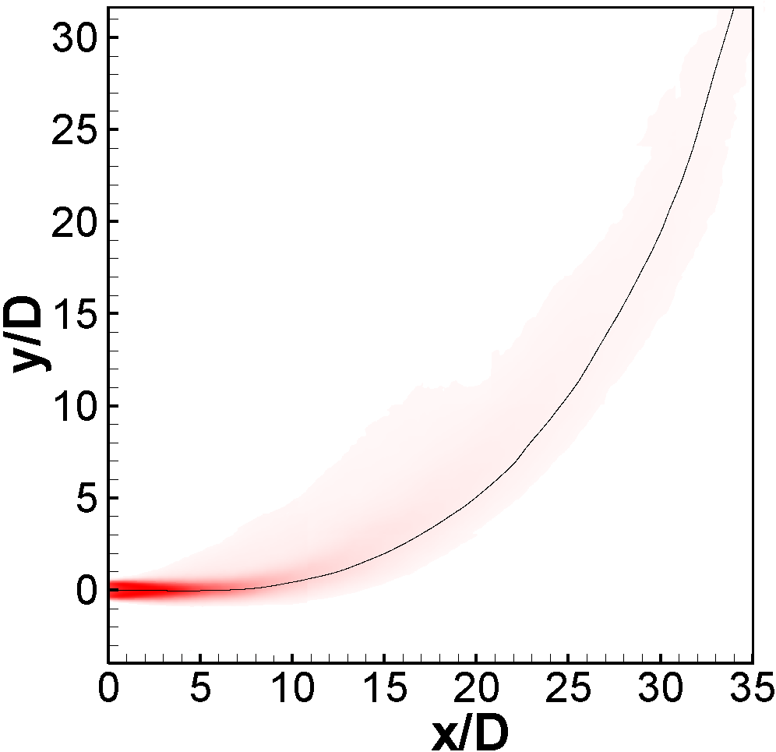
Jet Centerline
New coordinate system
Jet Centerline
Notes:
Due to bifurcated structure of the jet in cross-flow case and also in buoyancy dominated regions, it is preferable to use a new coordinate system. This new coordinate system reflects the flow evolution and jet spread in downstream locations.
<Click>
(s, n)-plane is jet new coordinate system in which s is distance along jet centerline and n is normal to the centerline.
<CLICK>
jet centerline was found by fitting a least square curve in the jet centerplane through the locus of points of maximum mean velocity magnitude
This process is shown in the figure for the case of Fr = 1000 as an example.

Slide 12
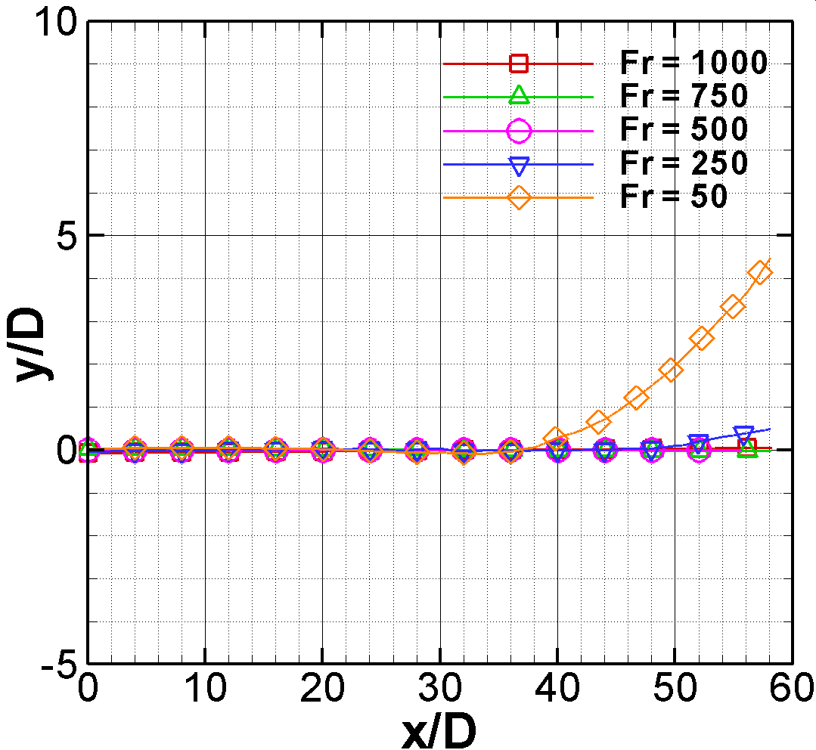
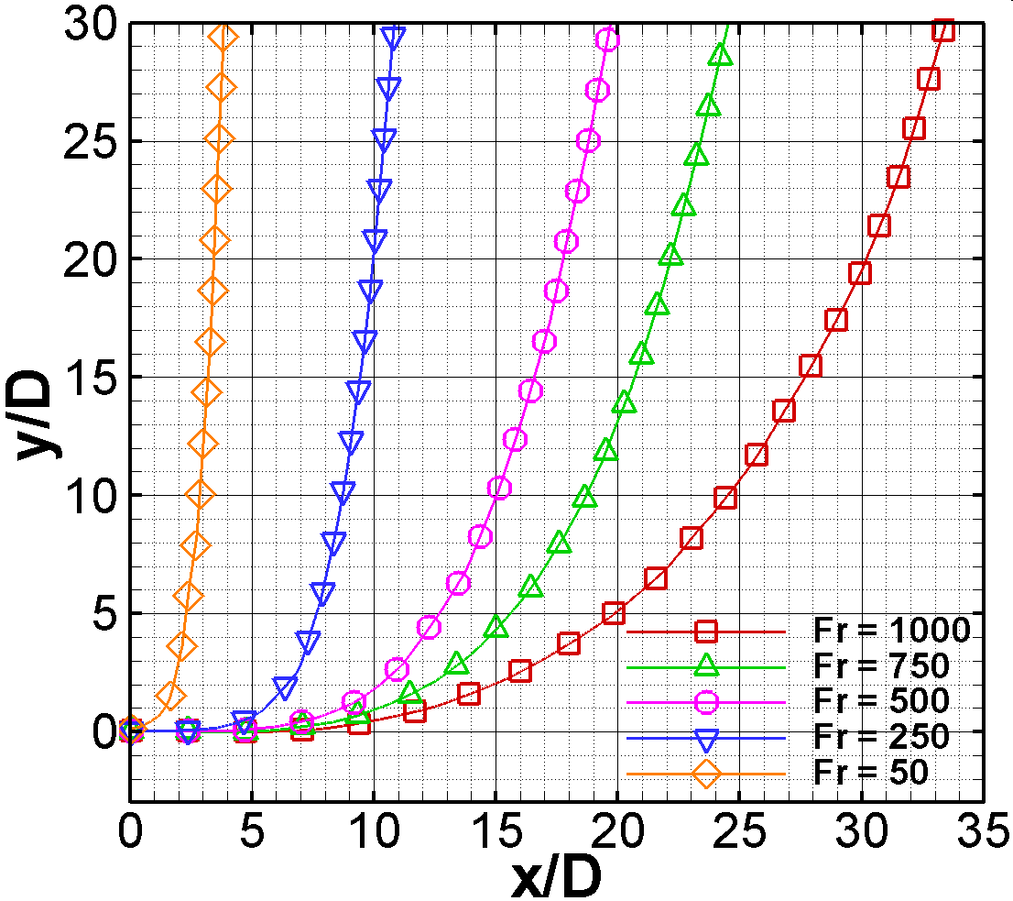
Jet Centerline (Continue)
Free Jet
Jet in Cross-flow
Notes:
Jet centerlines for both free and cross-flowing jet are represented in these figures. For the case of free jets for Froude>250 jets were momentum dominated and first effects of buoyancy occurred for Fr = 250 and for Fr = 50 jet centerline deviated from the nozzle centerline by almost 5D. And jet was divided into momentum and buoyancy dominated in jet near and far field regions.
For jet in cross-flow cases flows with lower Froude number penetrated less in the cross-flow assembly because of lower initial jet exit momentum.
Jet diameter “D” has been used as the scaling factor in these results. Using jet diameter as the length scale would be useful to analyze the “r” dependent properties of the jet. However different scaling factors are also used in these studies.

Slide 13
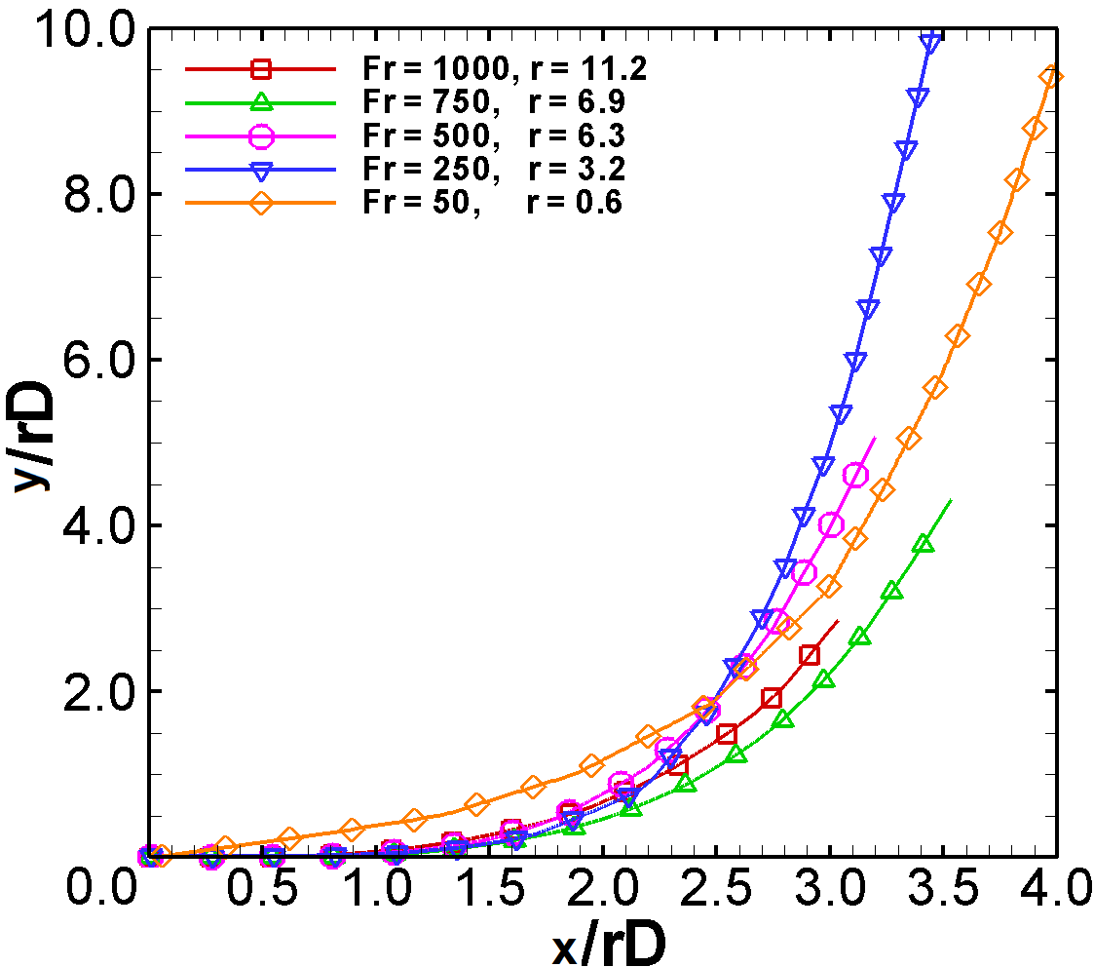
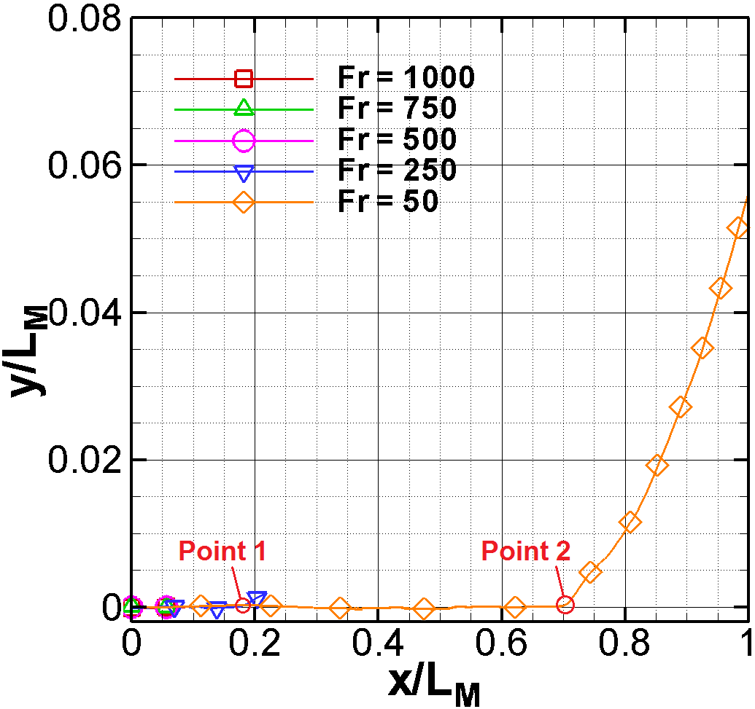
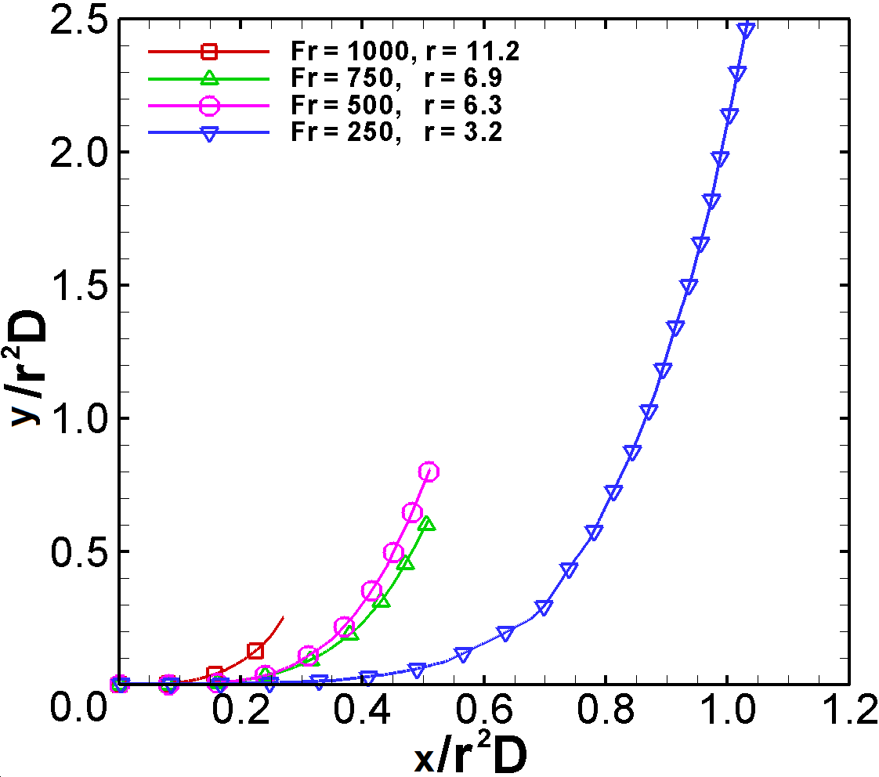
Scaling Factors
Free Jet
Jet in Cross-flow
first effects of buoyancy in case of Fr = 250 and 50, happens at approximately x/L_{M} = 0.16 and 0.61 which corresponds to x/D = 43 and 32 respectively.
rD scaling
scaling
Where
Notes:
In order to better identify the buoyancy and momentum dominated regions a momentum to buoyancy ratio was used as the normalization factor and it was observed that first effects of buoyancy in case of Fr = 250 and 50, happens at approximately x/L_{M} = 0.16 and 0.61 which corresponds to x/D = 43 and 32 respectively.
<CLICK>
In cases of the jet in cross-flow two other length scales has been used.
r2D: It was reported that the main advantage of employing r²D length scale as non-dimensionalizing factor is to discriminate jet near- and far-field regions (Mungal 1998). However jet centerlines did not collapse in these cases.
rD: It has been also reported by (Mungal 1998) that rD scaling can be used to identify the downstream location at which counter rotating vortex pair structure (CVP) is fully developed. Good centerline line collapse were experienced using rD as the normalization factor.

Slide 14
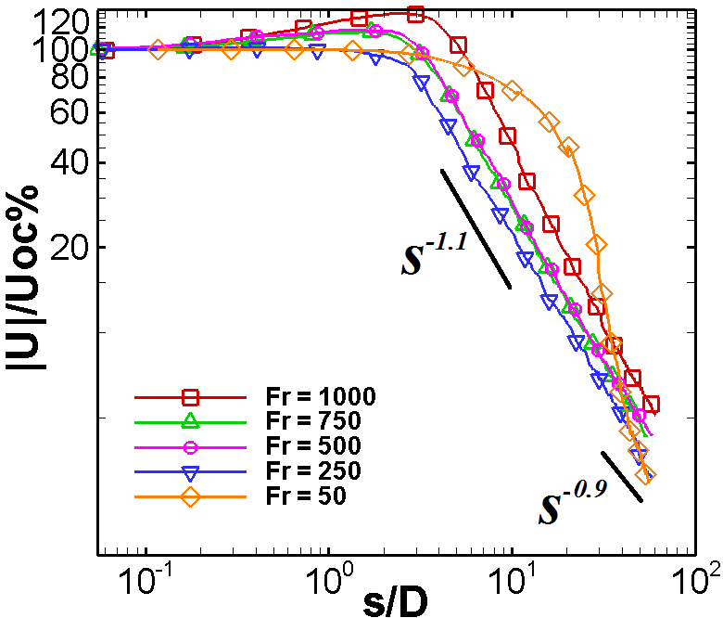
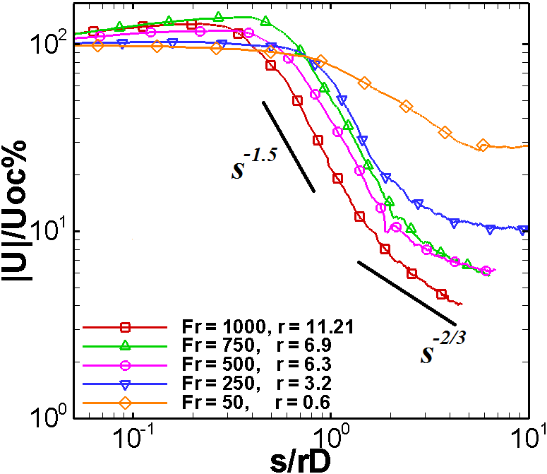
Velocity Decays
Free Jet
Jet in Cross-flow
Where:
Uoc is mean nozzle exit velocity
Notes:
normalized time-averaged velocity plot along jet centerline coordinate system s are shown in these figures. Centerline Velocity U is normalized by mean jet exit velocity Uoc and downstream distance along jet centerline, s, is normalized by jet diameter, D.
Decay rates are plotted in a log-log plot so the power law decays appear in a linear manner
Some conclusions can be drawn from these results:
Firstly, for the case of free jet decrease in Froude number led to a faster centerline decay with exception of Fr = 50 case in which centerline velocity persisted for almost 25D downstream because of laminar nature of the flow which transitioned to turbulence in farther downstream locations. Same behaviour was experienced in cross-flowing jets, as shown in the figure lower Froude number led to a smaller potential core area.
Centerline velocity decay lines undergo a sharp increase in the potential core region as a result of sharp edged orifice inflow condition.
Overall decay rates of free jet cases were faster comparing to jet dispersion from a contoured nozzle which is reported to be s-1 decay rate.
Overall decay rates of cross-flowing jets are faster comparing to free jet cases but in farther downstream this decay rates drop and jet structure decays slower than free jet cases.
Decay rates dropped at farther downstream distances in free jet cases due to presence of buoyancy driven acceleration components.

Slide 15
Velocity Decay (Continue)
1. Decay rates are faster in
cross- flowing jets
2. In jet far-field region
decay rates drop for jets in
cross-flow
3. Decay rate drops in
Buoyancy dominated
regions
NCF = Free jet
WCF = Jet in cross-flow
Notes:
Decay rates for the free jet cases and jet in cross-flow are compared together using jet diameter as the normalization factor.
Centerline decay rates for cases of Free and cross-flowing jets are illustrated in this figure. Two cases of Fr = 1000 and Fr = 250 are shown in the figure for momentum and buoyancy dominated flows respectively.
The decay rates are faster in cross-flowing jets.
Farther downstream decay rates drop because of presence of buoyancy driven acceleration components.
In free jet case in jet far-field region decay rates drop because of buoyancy forces.

Slide 16
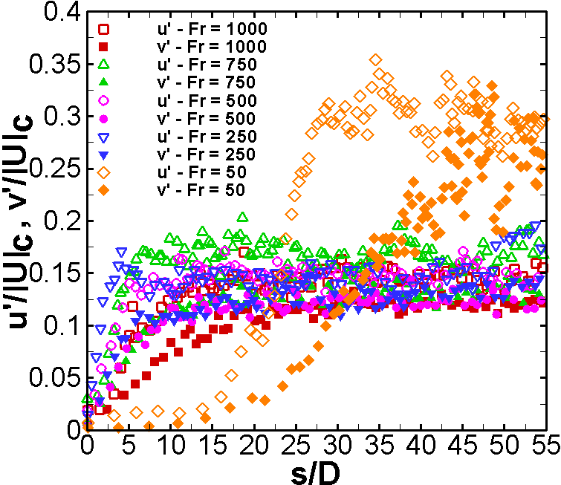
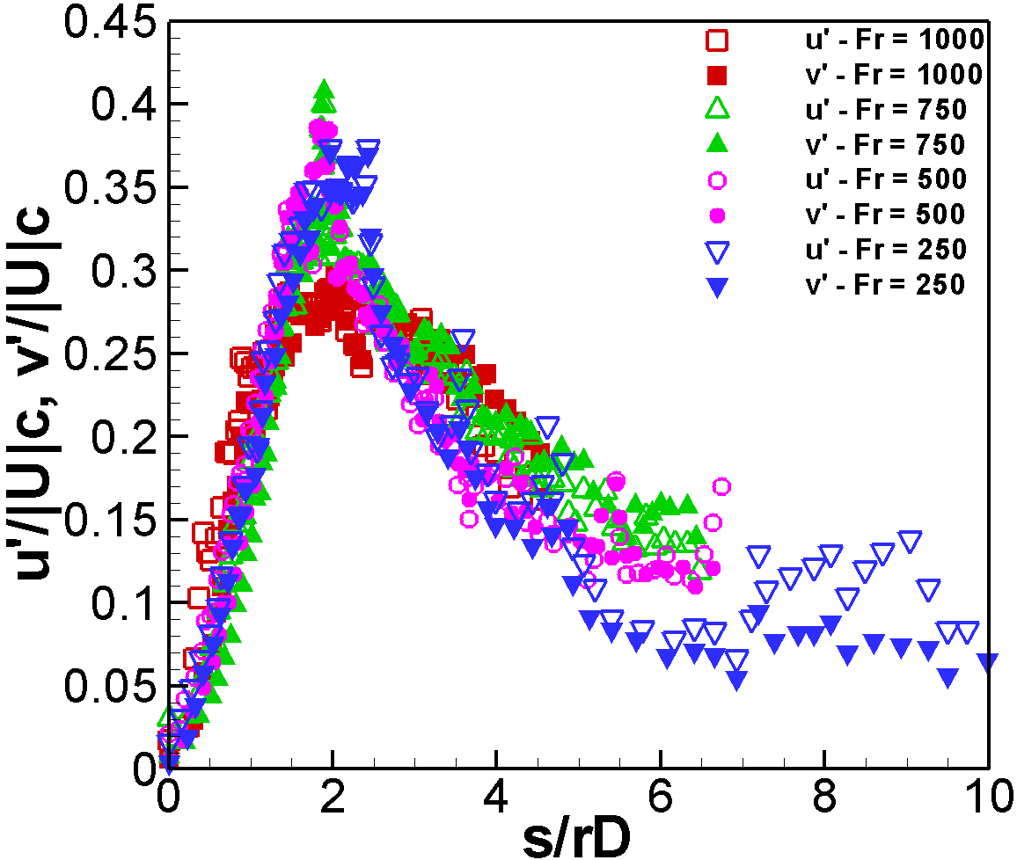
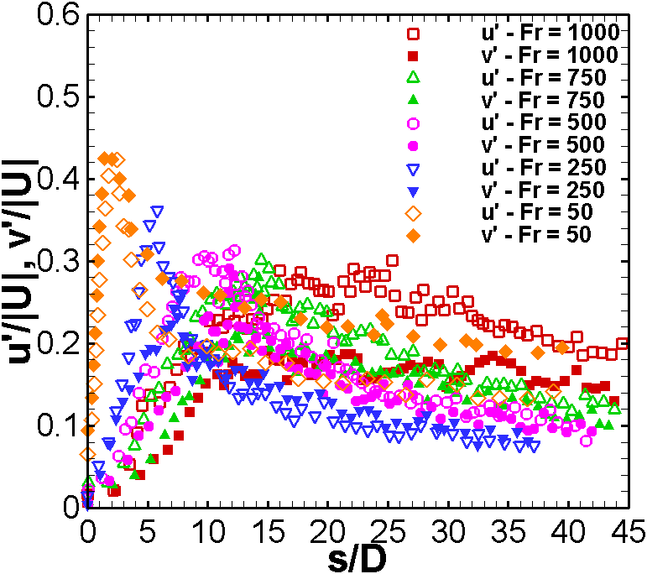
Turbulence Quantities
Free jet
Jet in cross-flow
Where, Uc is the time-averaged velocity magnitude along the jet centerline
Notes:
Normalized rms velocity components along jet centerline coordinate system are shown in the figure. RMS values are normalized by mean centerline velocity.
RMS values show a low initial value because of sharp-edged nozzle structure
Axial fluctuations are generally higher than radial fluctuation components.
At low Froude numbers velocity fluctuations increased in buoyancy dominated regions.
For Fr = 50 because of laminar structure of the flow in jet near-field area RMS value were very low which gradually increased in transition region
These rms values were generally substantially higher in presence of the cross-flow.
It is interesting to use rD factor for jet in cross-flow cases and it was experienced that rms plots collapsed on each other using this scaling factor with a peak at s=2rD which corresponds to a location at which jet is turning towards the cross-flow direction.

Slide 17
Conclusion
Effects of buoyancy and cross-flow were investigated in subsonic release of Helium,
Mean and fluctuation velocity components were quantified using PIV,
lowering the Froude number led to slower velocity decays due to the buoyancy-driven acceleration components in buoyancy dominated regions,
Increasing effects of buoyancy were observed by reducing the Froude number,
The present data can serve to validate computational models derived for investigating hydrogen safety scenarios.
Notes:
Effects of buoyancy and cross-flow were investigated in subsonic release of Helium.
Mean and fluctuation velocity components were quantified using PIV
lowering the Froude number led to slower velocity decays due to the buoyancy-driven acceleration components in buoyancy dominated regions.
Increasing effects of buoyancy were observed by reducing the Froude number.
The present data can serve to validate computational models derived for investigating hydrogen safety scenarios

Slide 18
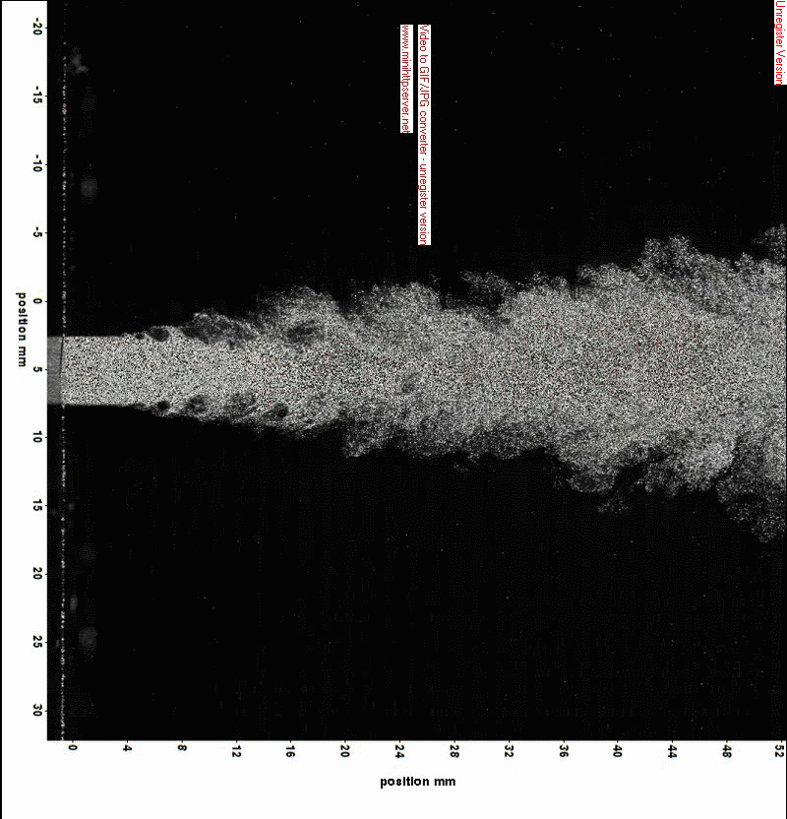
Thank you
Questions?

Slide 19
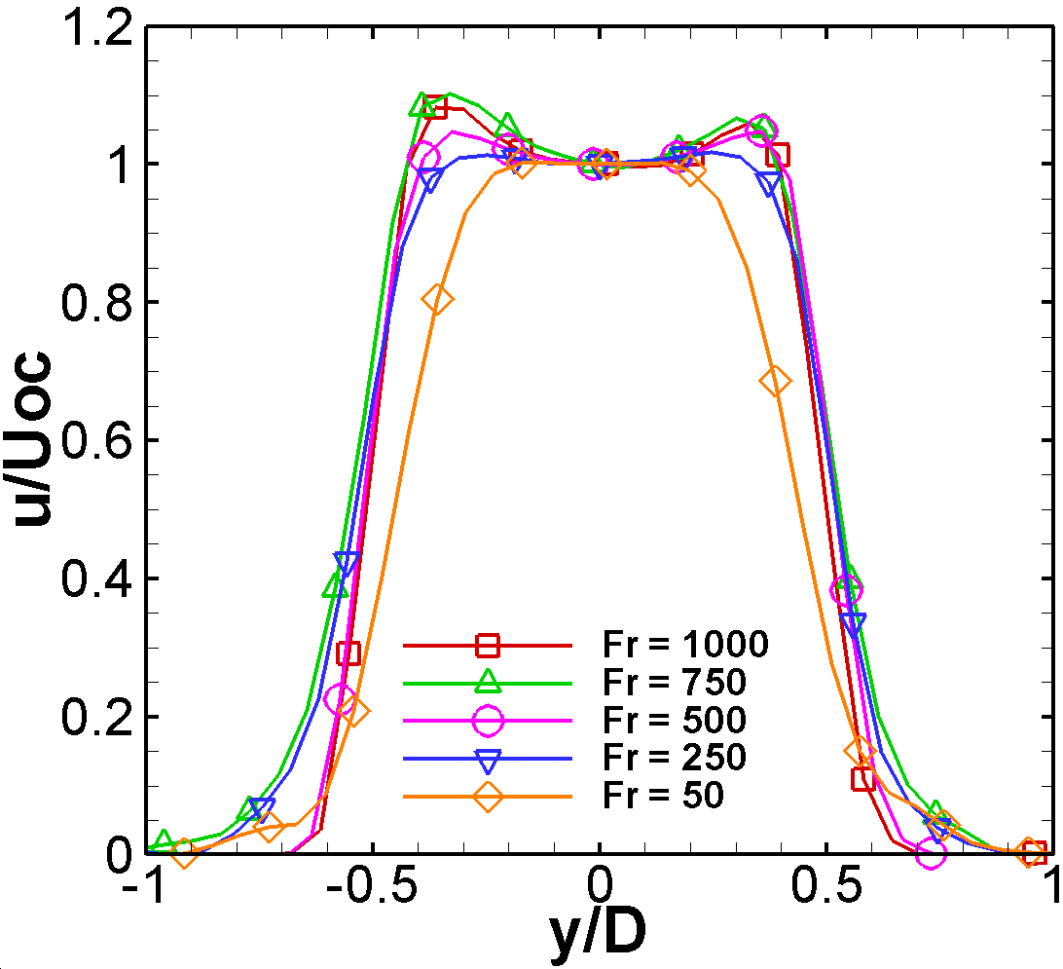
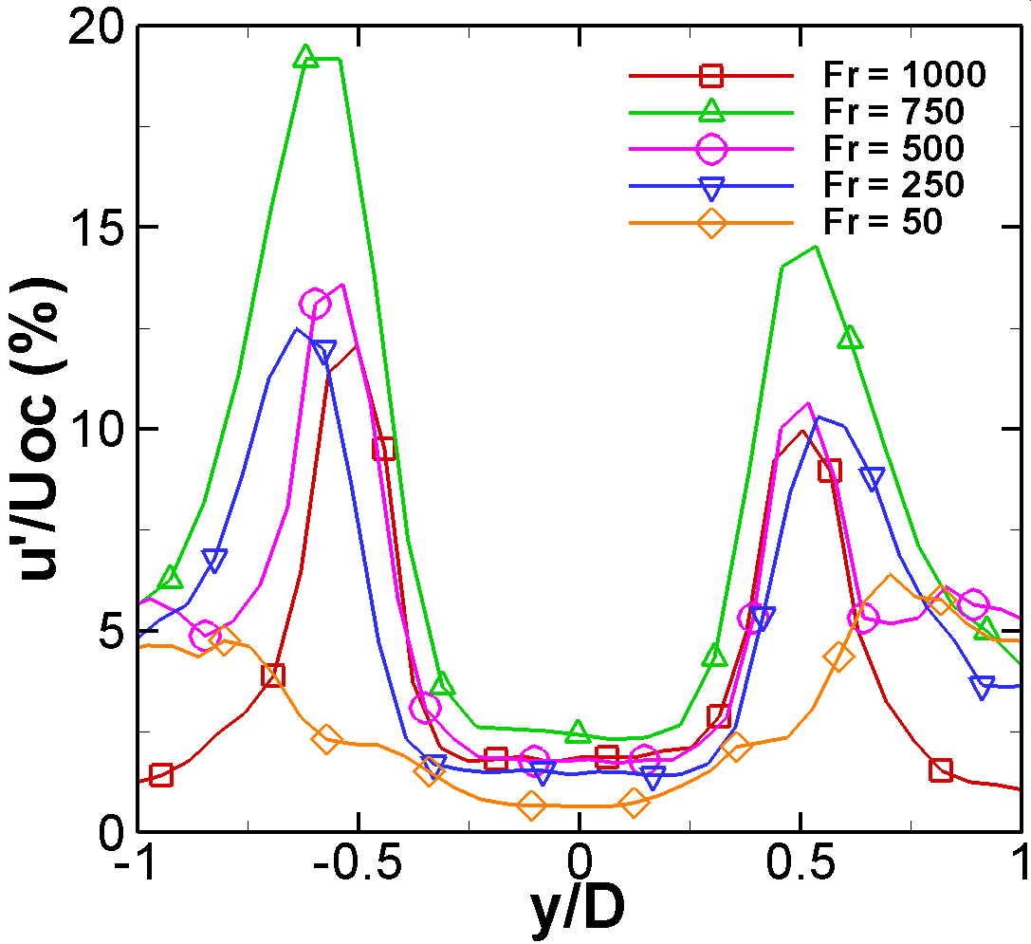
Appendix
Initial Condition – Sharp-edged Orifice
Notes:
The initial mean normalized radial velocity profiles together with corresponding normalized root-mean-square (rms) values are shown in figure. Higher Froude number causes more pronounced saddled-back initial velocity profile as a result of the higher initial momentum, which moves the point of the vena-contracta further downstream and causes a higher peak in centerline velocity profile. On the other hand, decreasing the Froude number moves the vena-contracta point towards the jet exit, which leads to a top-hat initial velocity profile and lower initial turbulent intensity. Should be identified and discussed in more detail, or this reference should be removed.

Slide 20
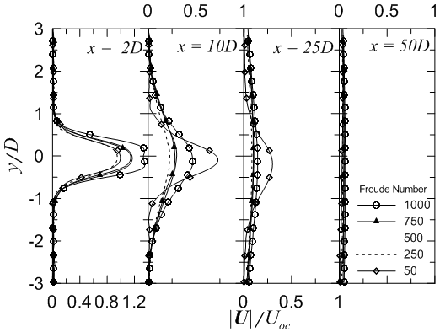
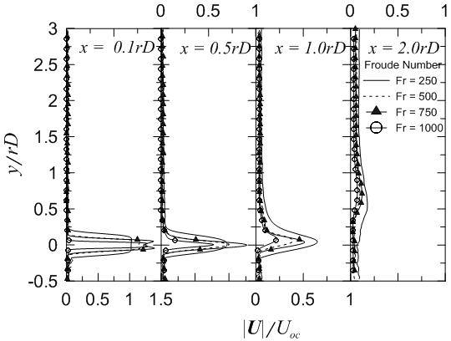
Velocity Profiles
Free Jet
Jet in cross-flow

Slide 21
Seeding - Stokes number
Seeding particles must:
Match fluid properties
Neutrally buoyant
Short response time to flow motion
Reflectivity
Particle Flow is dominated by Stokes drag:
For St>>1, particles will continue in a straight line regardless of fluid streamline but for St<<1, particles will follow the fluid streamlines closely.
Notes:
Stokes Drag: quantitative measure of the ability of tracer to follow the flow streamline.
Where: L and U are characteristic length and velocity of the flow respectively, τ – is relaxation time, which can be expressed as , where ρ and d are the density and typical diameter of the particle, μ is a dynamic viscosity of the fluid and C is a slip correction factor.

