Slide 1


Self-Ignition of Hydrogen Jet Fires by Electrostatic Discharge Induced by Entrained Particulates
Erik Merilo, Mark Groethe, Richard Adamo
SRI International
Robert Schefer, William Houf, Daniel Dedrick
Sandia National Laboratories
4th International Conference on Hydrogen Safety (ICHS)
San Francisco, California
September 12-14, 2011

Slide 2
Outline
Spontaneous Ignition of Large Hydrogen Releases
Introduction and Theory
Objective and Approach
Experimental Setup
Static Charge Buildup Results
Attempted Self-Ignition Results
Summary

Slide 3


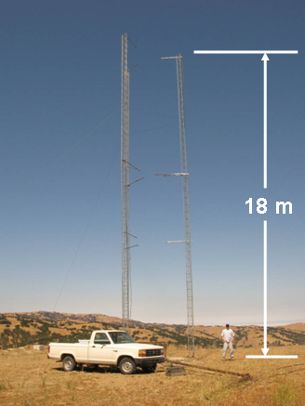
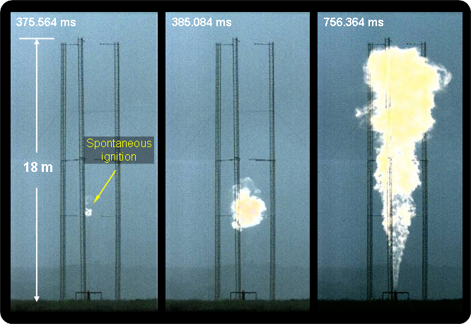
Spontaneous Ignition: Example
Groethe, M., Merilo, E., Colton, J., Chiba, S., Sato, Y. and Iwabuchi, H., Large-scale Hydrogen Deflagrations and Detonations, International Journal of Hydrogen Energy, 32(13), 2007, pp. 2125-2133.
.
Ignition occurred 100% of time for release pressures above 24 atm and leak diameters of 42 mm
Ignition location occurred near equipment support struts
The ignition point is 6 m above the jet exit and in subsonic flow. Thus, shock heating is not the ignition source.
High-Speed Video
Study performed for
NEDO and IAE in Japan

Slide 4
Spontaneous Ignition of Hydrogen
Astbury and Hawksworth (2007) performed a review of spontaneous ignition incidents and of postulated mechanisms
  For 86% of incidents the source of ignition was not identified
  Discussed four potential mechanisms of spontaneous ignition:
  Reverse Joule-Thomson effect
  Electrostatic ignition
  Diffusion ignition
  Hot surface ignition
Diffusion ignition has been the primary focus of subsequent research
Very limited research has been performed to investigate electrostatic ignition
Astbury, G.R., & Hawksworth, S.J. (2007). Spontaneous ignition of hydrogen leaks: Review of postulated mechanisms. International Journal of Hydrogen Energy, 32, 2178–2185.

Slide 5
Conditions Required for an Electrostatic Discharge Ignition
Ignition of a flammable mixture is not caused by charge buildup alone
A number of stages must occur for the charge to ignite a mixture (ISSA, 1996; Hearn, 2002):
Charge separation (generation of electrostatic charge)
Charge accumulation
Charge removal
  Charge removal by dissipation → no ignition
  Charge removal by electrostatic discharge → possible ignition
Presence of a flammable mixture
Discharge energy greater than the minimum ignition energy
ISSA. (1996). Static electricity: Ignition hazards and protection measures. ISSA: Heidelberg, Germany.
Hearn, G.L. (2002). Static electricity: Guidance for plant engineers. http://www.wolfsonelectrostatics.com/info_pdfs/guidanceforplantengineers-staticelectricity.pdf

Slide 6
Proposed Mechanisms for Electrostatic Discharge Ignition of Hydrogen Release
Charge separation (generation of electrostatic charge)
  Potential for solid particles to be present in hydrogen systems
  When iron oxide particles move through pipes, interaction between the particles and the pipe wall can lead to charge separation by triboelectric charging.
    Triboelectric charging is a type of contact charging that takes place when two different materials are rubbed against each other
Charge accumulation
  Occurs when the rate of charge separation exceeds the charge dissipation rate
  Charge can accumulate on entrained particles
    Generates an electric field
    Electric field can charge conductors in close proximity by induction
  Impact charging by particles can cause charge accumulation to occur on objects in the release

Slide 7
Proposed Mechanisms for Electrostatic Discharge Ignition of Hydrogen Release
Charge removal by electrostatic discharge
  Spark discharge between isolated conductors
  Brush discharge
  Corona discharge
Presence of a flammable mixture
  Wide flammability range of hydrogen means that a release could produce a sizeable volume of flammable mixture
Discharge energy greater than the minimum ignition energy
  Hydrogen has a very low spark discharge energy required for ignition
    For a near stoichiometric mixture, the minimum ignition energy of hydrogen and air is 0.017 mJ (Ono & Oda, 2008)
    Near the flammability limits, the spark ignition energy required to ignite a hydrogen-air mixture is only about 6 mJ
Ono, R., & Oda, T. (2008). Spark ignition of hydrogen-air mixture. Journal of Physics: Conference Series, 142, 012003.

Slide 8
Static Charge Buildup: Objective & Approach
Objective
  Determine if static charge accumulation on iron oxide particles entrained in a hydrogen jet release could lead to a spark discharge ignition or a corona discharge ignition.
Approach
  Initial baseline tests with only hydrogen
  Ignition tests with energy input from an external power supply
  Entrained particulate electrification characterization tests
  Self ignition by entrained electrified particulate

Slide 9
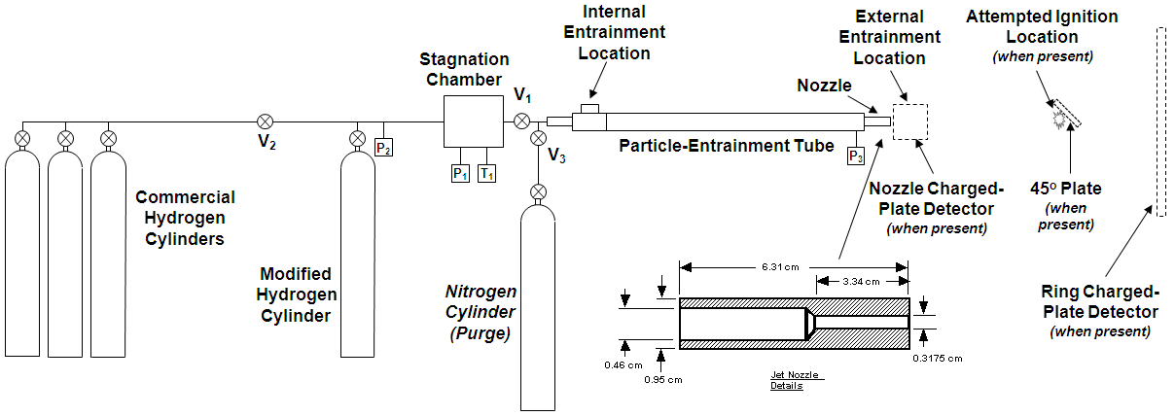
Release Facility

Slide 10
Ignition Tests with Energy Input from an
External Power Supply

Slide 11
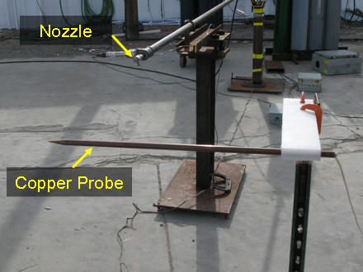
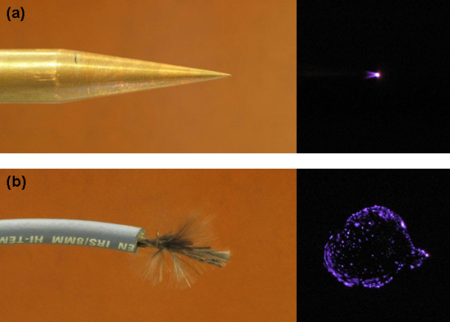
Ignition Tests with External Power Supply
110-mJ spark was used to show the release could be ignited at the selected location
Four tests were conducted with a 10 kV-17kV AC corona generator connected to a copper probe
  No ignition events occurred
AC corona

Slide 12
Entrained Particulate Electrification Characterization Tests

Slide 13
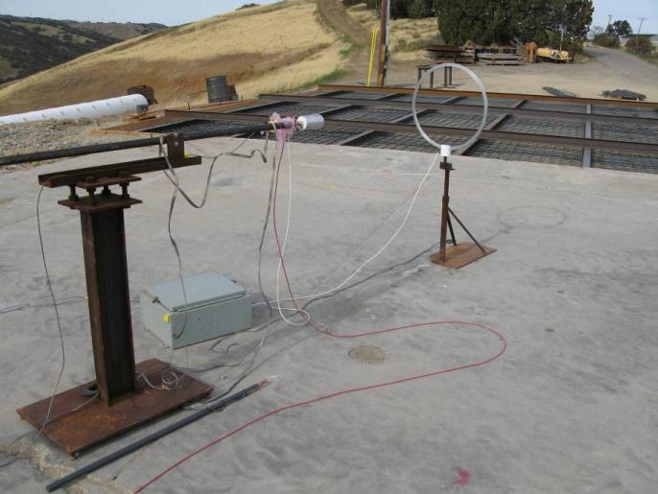
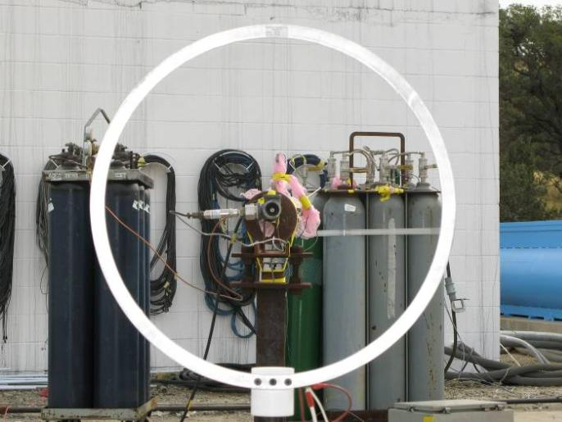
Entrained Particulate Electrification Characterization Tests
Nozzle
Nozzle
Ring Charged Plate Detector
Ring Charged Plate Detector
Charge accumulation caused by iron oxide particles in the flow was evaluated by measuring voltage on detectors surrounding the release jet
Static level monitoring system was used to make measurements

Slide 14
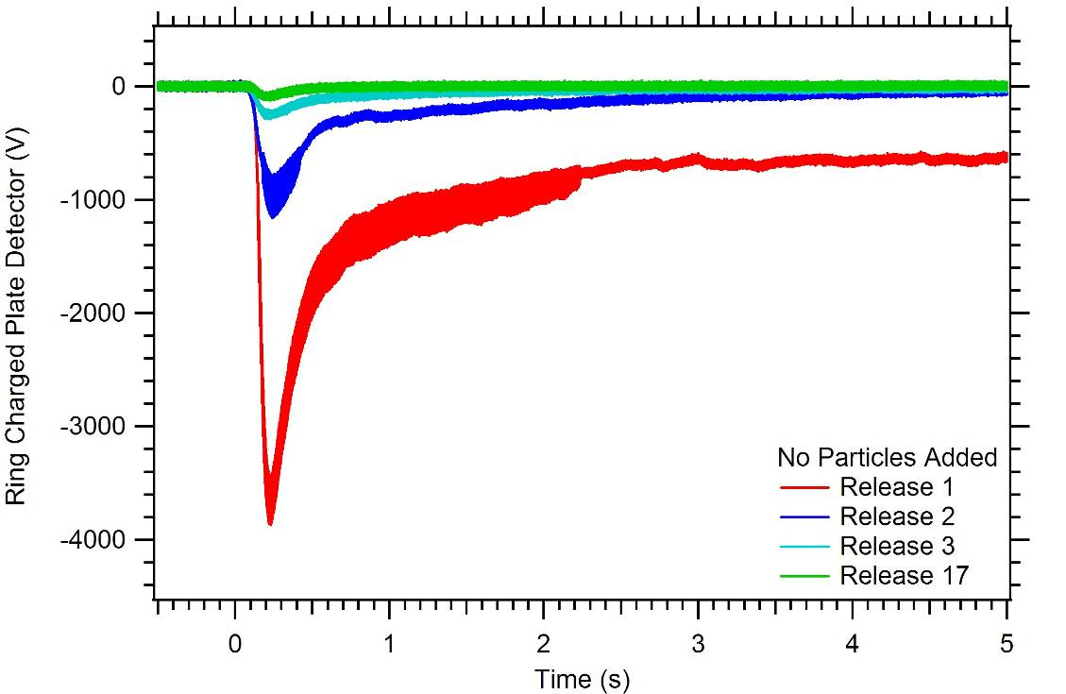
Release Characterization Tests
Electrostatic potential measurement on the ring charged-plate detector
for release tests with no particles added
Ring Charged-Plate Detector

Slide 15
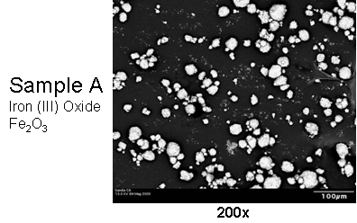
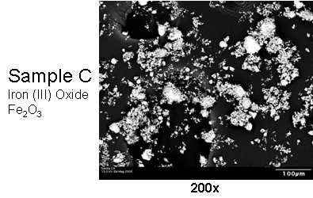
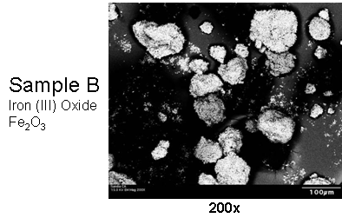
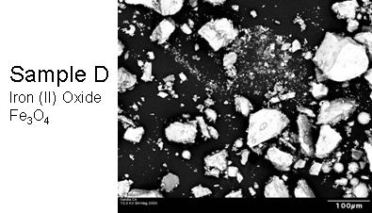
Iron Oxide Particles
Four iron oxide samples were tested: three iron (III) oxide and one iron (II) oxide.
All four particles were tested in external particle entrainment tests
200x

Slide 16
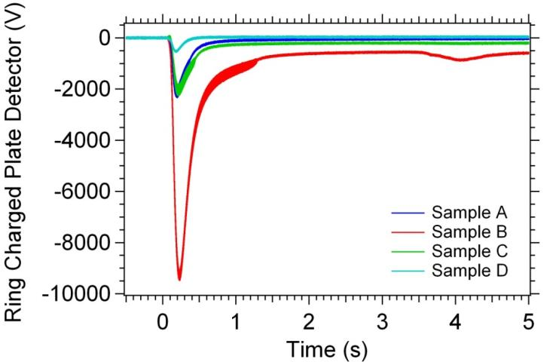
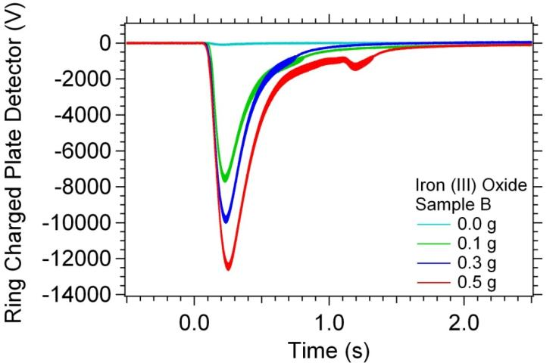
Voltage Induced on the Charge Plate
Variation of Particle Sample
Variation of Total Particle Mass
All four iron oxide particles induced a negative charge on the detector
  Electrons were stripped, giving particles a positive charge
  Of the four samples, Sample B produced the highest charge
  Sample B was selected for the internal entrainment tests
Charge increased with increasing particle mass.

Slide 17
Self Ignition by Entrained Electrified Particulate

Slide 18
Self Ignition by Entrained Electrified Particulate
Ignition experiments focused on two phenomena associated with electrostatic discharge ignition of hydrogen jets:
  Spark discharges from isolated conductors
  Corona discharges
Three types of ignition events were observed:
  Floating plate with grounded probe ignition
  Ungrounded plate ignition
  Nozzle charged plate detector ignition

Slide 19
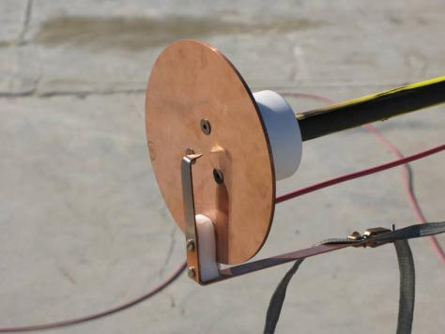
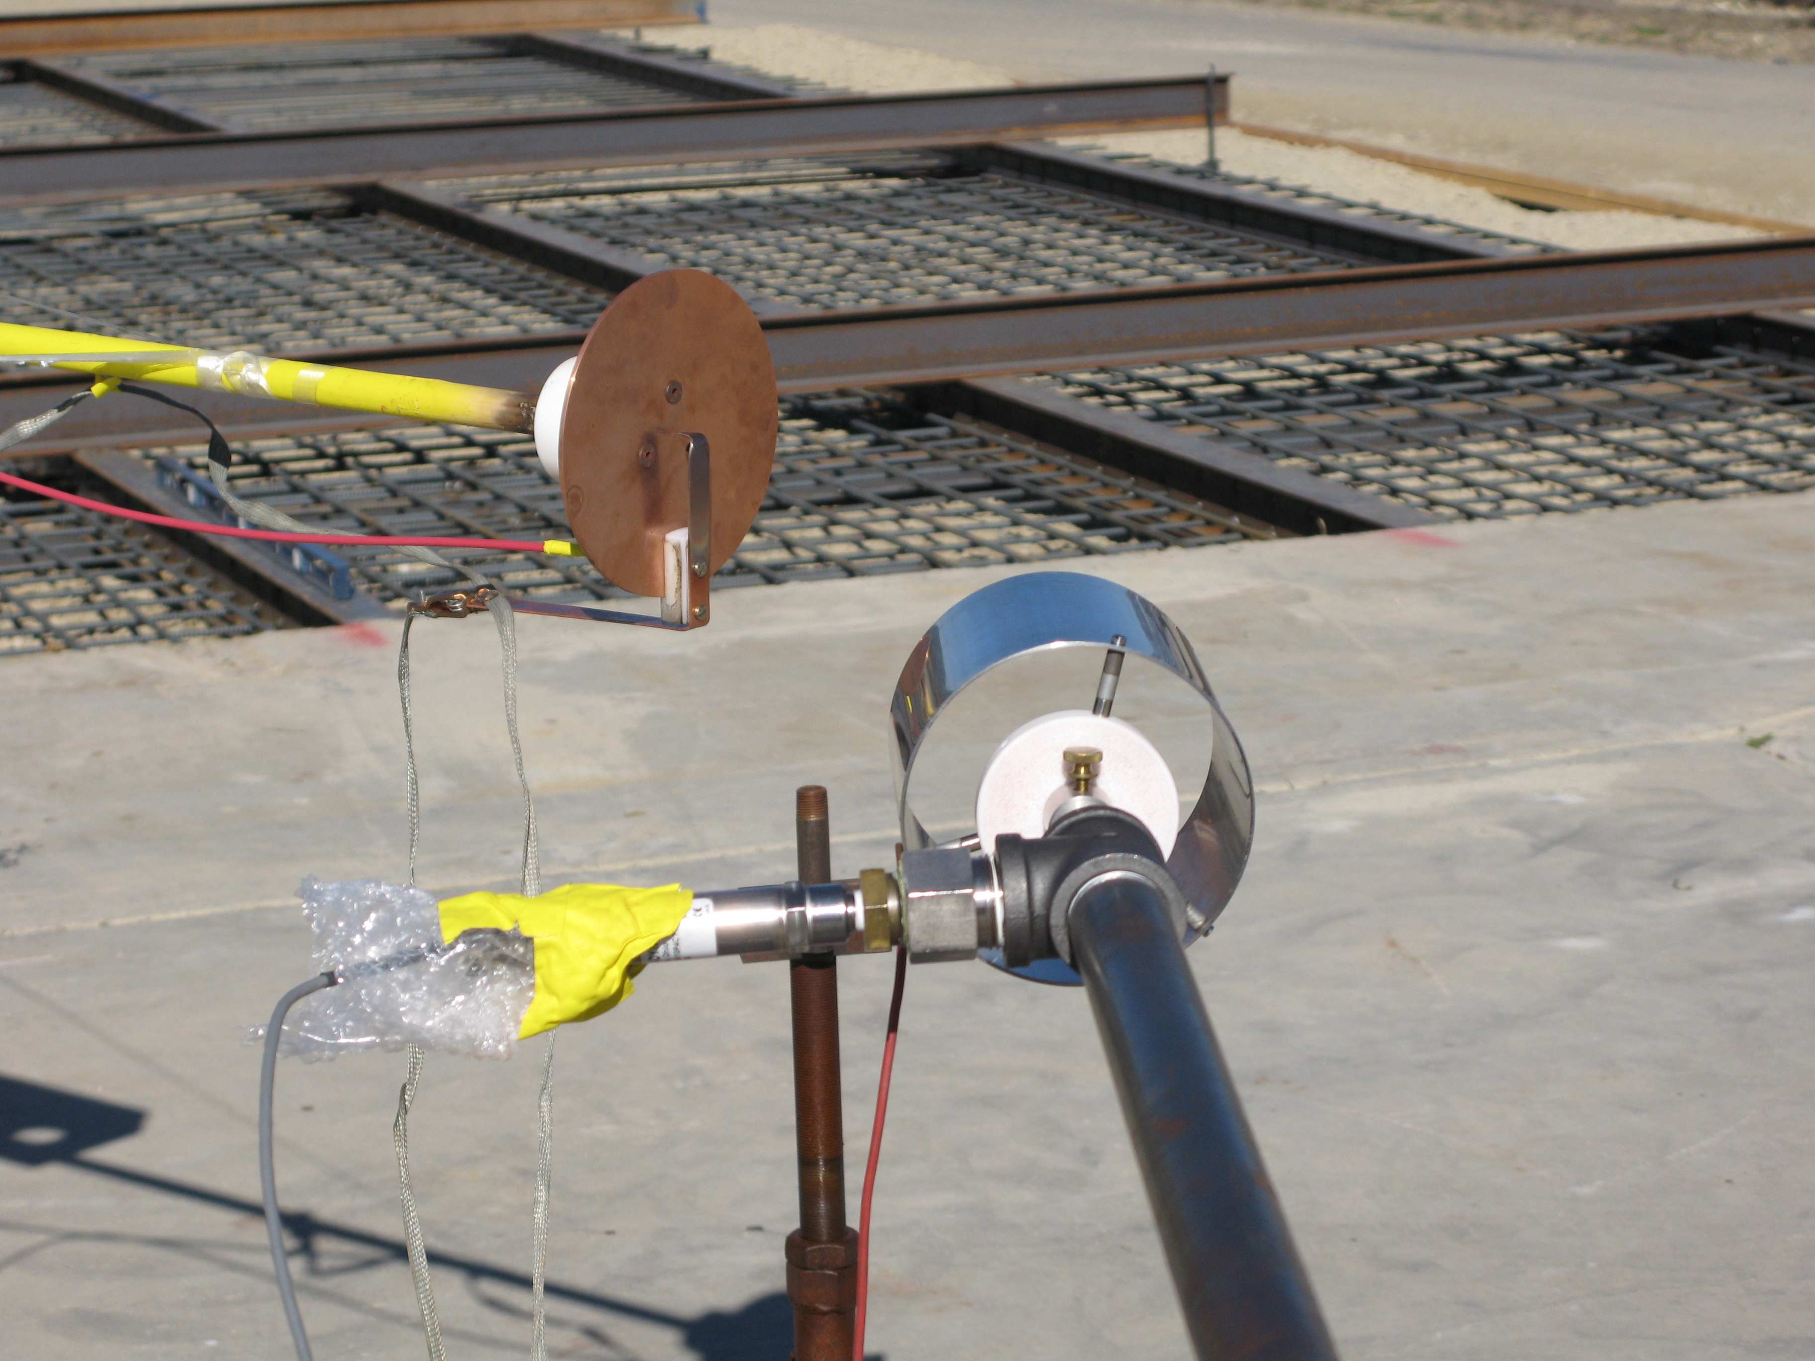
Floating Plate with Grounded Probe Ignition
A series of ignition tests were performed with a circular ungrounded plate in close proximity to a grounded probe
In this configuration six ignitions occurred
Ignition occurred in three out of four tests with only 0.1 g of iron (III) oxide particles present
Results show that entrained particulates can be a source of spontaneous ignition
Ungrounded Plate
Grounded Probe

Slide 20
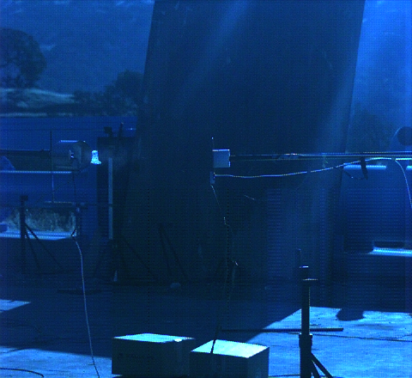
High Speed Video:
Floating Plate with Grounded Probe Ignition

Slide 21
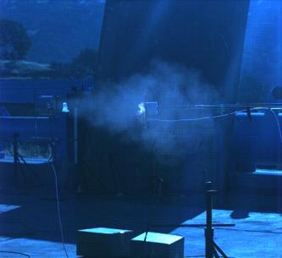
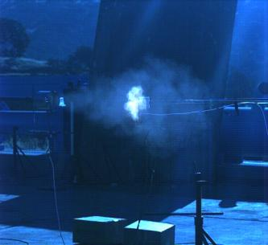
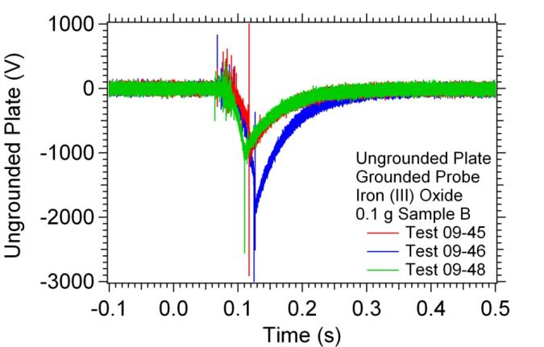
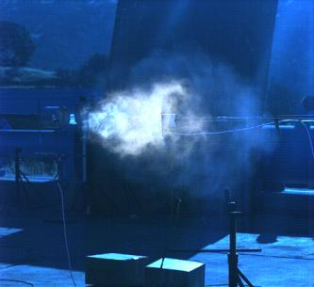
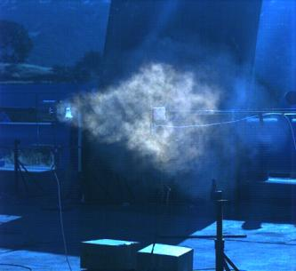
Floating Plate with Grounded Probe Ignition
Ignition occurred in 6 of 8 tests
Available spark discharge energies between 0.094 and 0.358 mJ
0.80 ms
Ignition
1.60 ms
Nozzle
Ungrounded Plate
10.80 ms
18.80 ms
Ignition

Slide 22
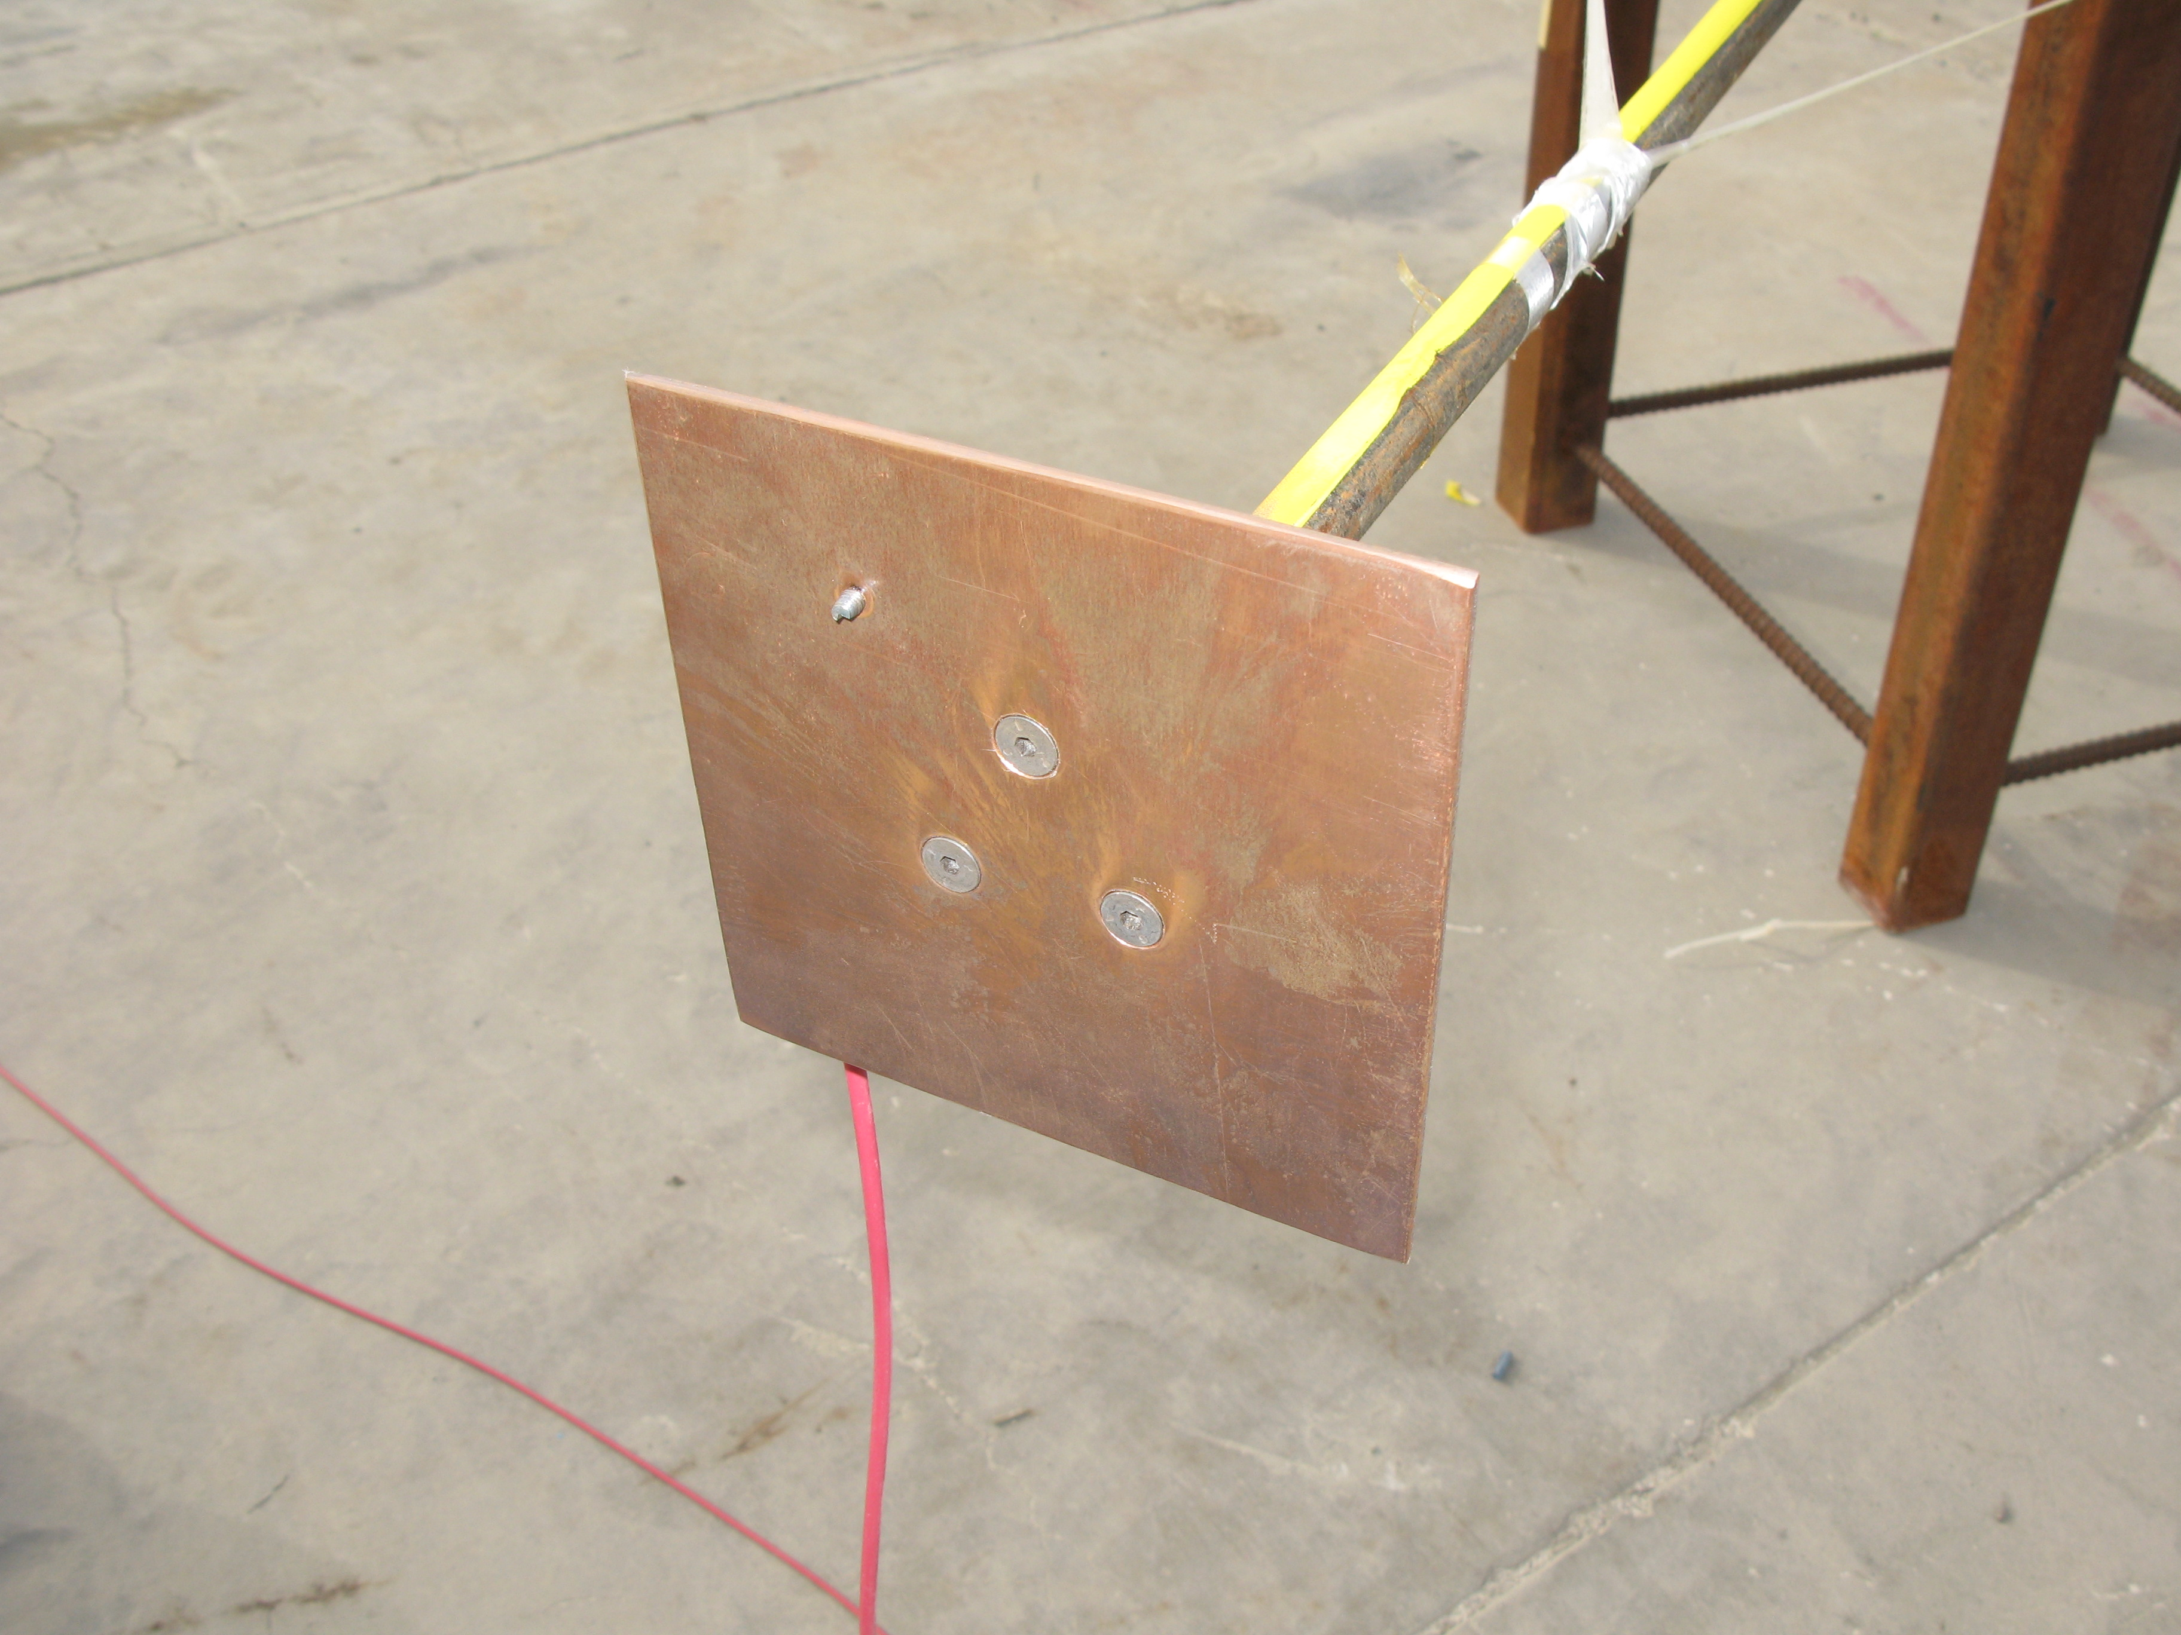
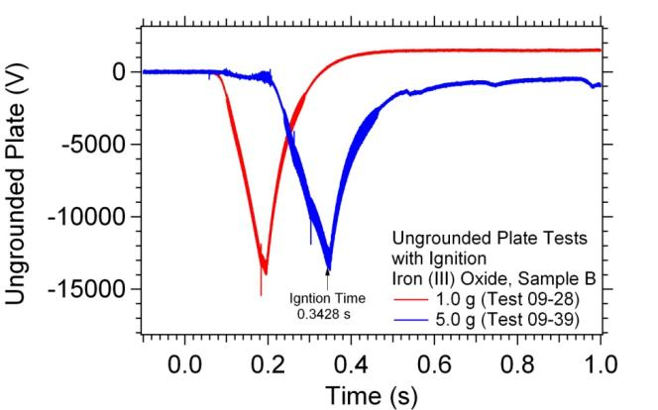
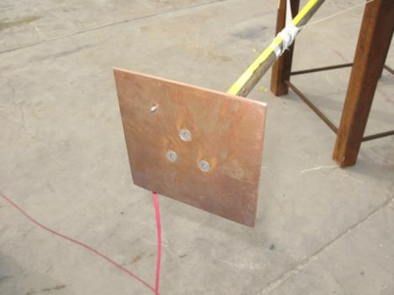
Ungrounded Plate Ignition
Ungrounded copper plate was used to investigate the potential for charged particles causing a spontaneous ignition event by a corona discharge
13 tests were conducted with the ungrounded plate resulting in two ignition events
Two ignition mechanisms appear possible:
  Electrostatic spark discharge
  Corona discharge
Possible electrostatic discharge between ungrounded plate and ungrounded cable housing
Difficult to force a corona discharge ignition to occur with this geometry
Ungrounded Plate
Ignition

Slide 23
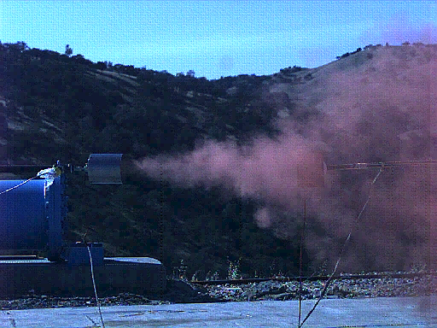
High Speed Video: Ungrounded Plate Ignition

Slide 24
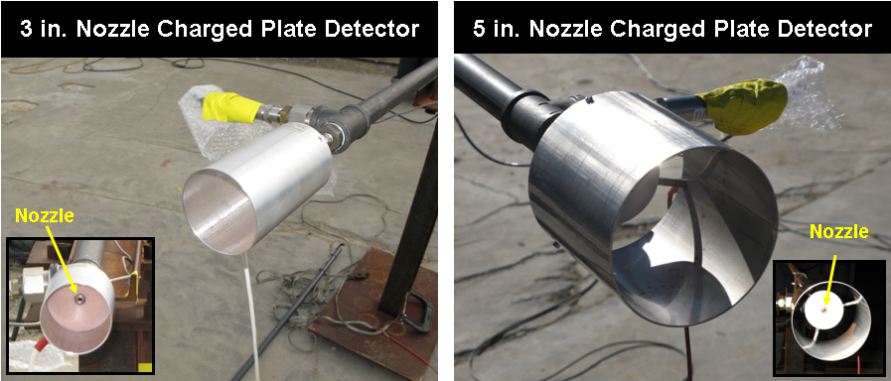
Nozzle Charged Plate Detector Ignition
Four ignition events occurred in close proximity to an ungrounded metal tube surrounding the jet next to the release nozzle
No ignitions occurred when a nozzle charged plate detector was not present
No ignitions of this type occurred without particles entrained in the flow.
More research is required to determine the cause of these ignitions

Slide 25

High Speed Video: Nozzle Charged Plate Detector Ignition

Slide 26
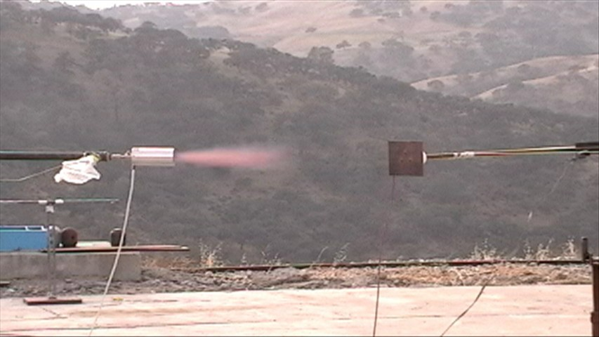
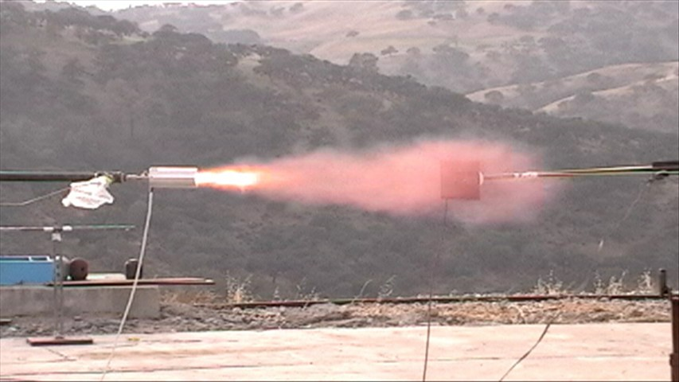
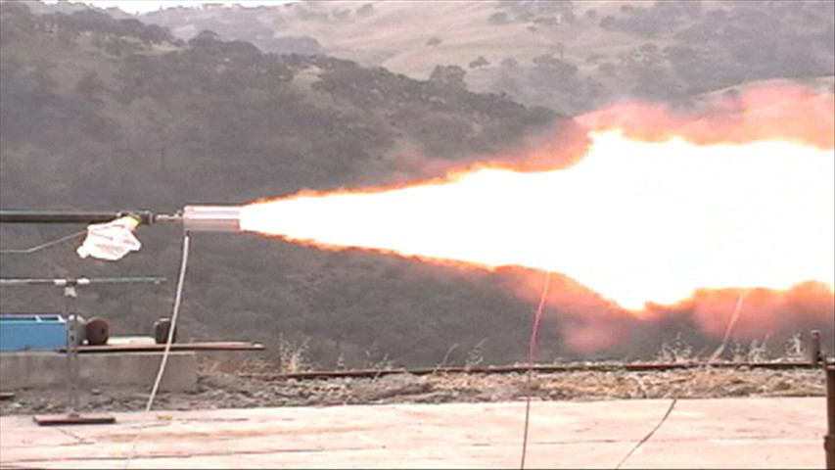
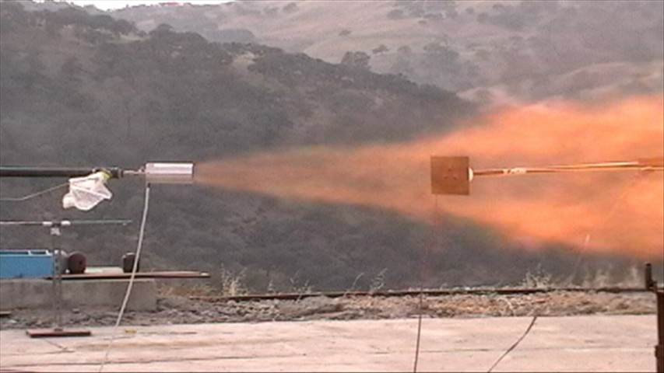
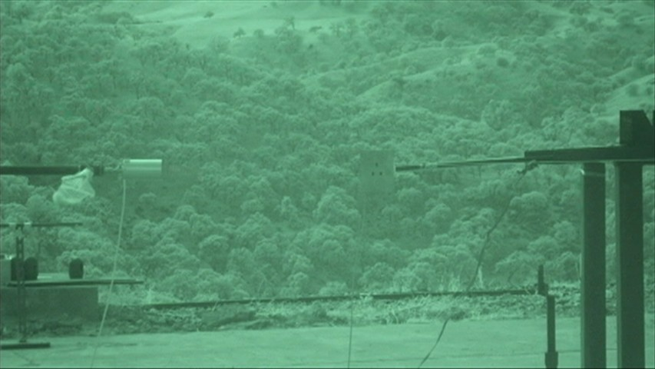
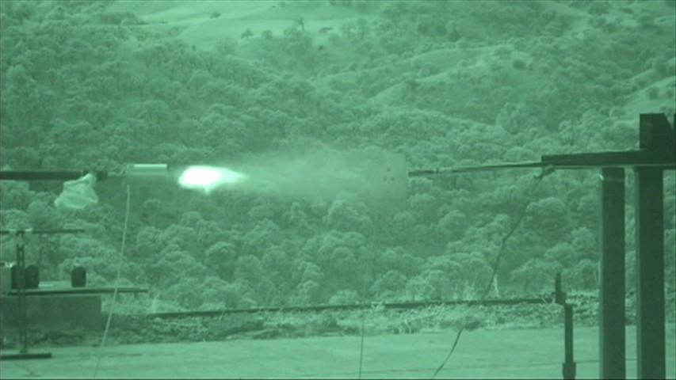
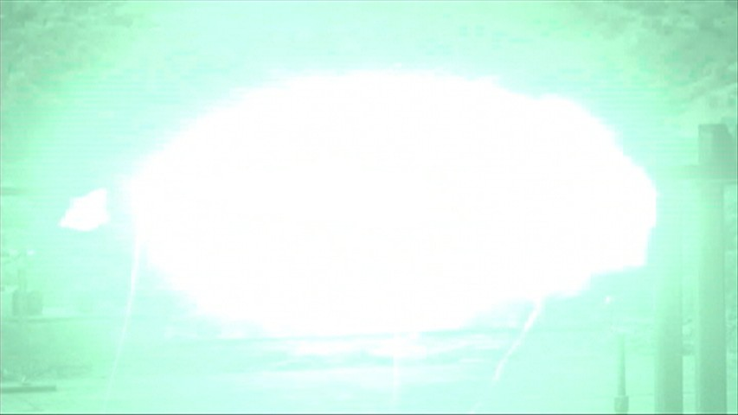
Nozzle Charged Plate Detector Ignition: Standard and IR Video
~ -33 ms
~ 0 ms
~ 33 ms
Ignition
H₂ Jet
~ -33 ms
~ 0 ms
Ignition
~ 33 ms
Standard and IR video frames show that the iron oxide particulate had already exited the nozzle and that the hydrogen jet extended between 0.3 and 0.9 m away from the nozzle before ignition occurred
This indicates that the ignition events were not related to diffusion ignition

Slide 27
Static Charge Buildup: Summary
Iron oxide particles had positive charge in all tests
  Electrons were removed
  Iron (III) oxide produced higher charge than iron (II) oxide when a comparable mass of particulates was used
Experiments showed that entrained particulates can be a source of spontaneous ignition
  Ungrounded plate in close proximity to a grounded probe caused ignition to occur in 6 out of 8 tests
All ignition events observed in this study occurred in close proximity to ungrounded metal objects
  No ignition events were observed in the presence of grounded metal alone
Ungrounded metal plates were charged as high as -41.5 kV with no ignition occurring
  Result suggests that inducing a corona discharge with electrified particulate is unlikely for the geometries studied

Slide 28

Acknowledgment
This work was supported by the U.S. Department of Energy, Office of Energy Efficiency and Renewable Energy, Hydrogen, Fuel Cells and Infrastructure Technologies Program under the Codes and Standards subprogram element managed by Antonio Ruiz.

Slide 29
Questions?

Slide 30
Discharge Mechanisms: Spark Discharge
Occurs when isolated conductors in close proximity are charged to different electrostatic potentials
  Electric field is formed
  If the field strength exceeds the breakdown strength of the surrounding atmosphere, a spark discharge can result
    Breakdown strength about is 30 kV/cm under normal atmospheric conditions
A spark discharge is a discrete discharge where a single plasma channel is formed across the gap between the conductors
Charged Conductor

Slide 31
Discharge Mechanisms: Brush Discharge
Can occur when a conductive electrode is brought into an electric field of sufficient strength
  Electrode radius of curvature is greater than
  3 to 5 mm (Luttgens & Glor, 1989).
  Can take place regardless of the field’s origin (Glor, 2003).
The presence of the electrode distorts the field
  Dielectric strength of the surrounding gas can be exceeded locally
Several separate plasma channels can form on the surface of the electrode.
+
+
+
+
+
+
+
+
Charged Object
Glor, M. (2003). Ignition hazard due to static electricity in particulate processes. Powder Technology, 135–136, 223– 233.
Luttgens, G., & Glor, M. (1989). Understanding and controlling static electricity. Expert Verlag.

Slide 32
Discharge Mechanisms: Corona Discharge
The conditions required are similar to those that create a brush discharge
Generated in areas of high field strength
  Can develop around sharp points
Occurs when the field strength exceeds the breakdown field strength of the surrounding medium
  Ionizes and becomes conductive
    Ionization of the surrounding fluid is limited to the region around the conductor where the field strength is exceeded
  Current flows
The critical voltage at which a corona discharge will occur is influenced by:
  Geometry of the point
  Distance to ground
  Properties of the surrounding mixture
+
+
+
+
+
+
+
+
+
Charged Object

Slide 33
Discharge Mechanisms
The type of discharge that can occur is influenced by the conductivity of the materials used and the geometric configuration
When objects are charged, an electric field is formed around the objects
If the charge is high enough, there can be locations where the electric field exceeds the dielectric strength of the surrounding gas, and a discharge by ionization takes place
The dielectric strength of a gas depends on the ionization energy of the molecules and the mean free path of electrons, and is therefore dependent on gas composition and pressure

Slide 34
Discharge Incendivity
Incendivity is the ability of a discharge to ignite a flammable mixture
The incendivity of a discharge is dependent on:
  Total energy released
  Time and spatial distribution of energy
Can be affected by humidity and temperature
Total energy of a discharge can be used to estimate its incendivity
Spark discharges are the most incendive discharges (Glor, 2003).
Brush discharges are more incendive than corona discharges
Objects charged to a negative potential are significantly more incendive than objects charged to a positive potential (Luttgens & Glor, 1989).
Glor, M. (2003). Ignition hazard due to static electricity in particulate processes. Powder Technology, 135–136, 223– 233.
Luttgens, G., & Glor, M. (1989). Understanding and controlling static electricity. Expert Verlag.

Slide 35
Discharge Incendivity
While calculating the discharge energy associated with a spark discharge is straightforward, for other types of discharge calculations are highly complex
The best way to determine the incendivity of a discharge and to approximate its energy is through a phenomenological approach
  In doing so, the equivalent energy of a discharge can be established
  Determined by matching the ignition threshold for the discharge to the required spark discharge energy for a flammable mixture
Maximum equivalent energy of discharge (Britton, 1999)
Discharge | Maximum Equivalent Energy
Spark discharge | Virtually unlimited
Propagating Brush Discharge (PBD) | ≈ 100–1000 mJ
Brush discharge (positive) | ≈ 10 mJ
Brush discharge (negative) | ≈ 1.0 mJ
Corona discharge (positive) | ≈ 0.1 mJ
Britton, L.G. (1999). Avoiding static ignition hazards in chemical operations: A CCPS concept book. American Institute of Chemical Engineers: New York, NY.

Slide 36
Probe Configurations
Probe
Charged Particles
H₂ Jet
+
+
+
+
+
+
+
+
+
+
+
+
+
+
+
+
+
+
+
+
+
+
+
Measure charge buildup on probe
Perform tests with no particles to show that shock initiation is not occurring
Ungrounded
Grounded Probe with Floating Charge Collection Plate
Charged Probe
+
+
+
+
+
+
Ungrounded
+
+
+
+
+
+
+
+
+
V
-
Grounded Probe (2008 test)
A
A
Plate builds up charge and creates a corona or spark that could ignite the gas
36

Slide 37
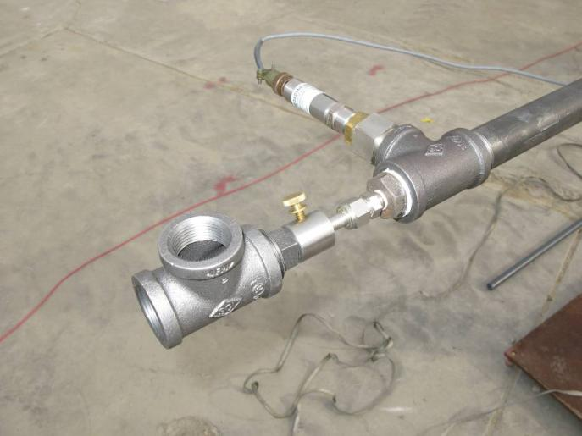
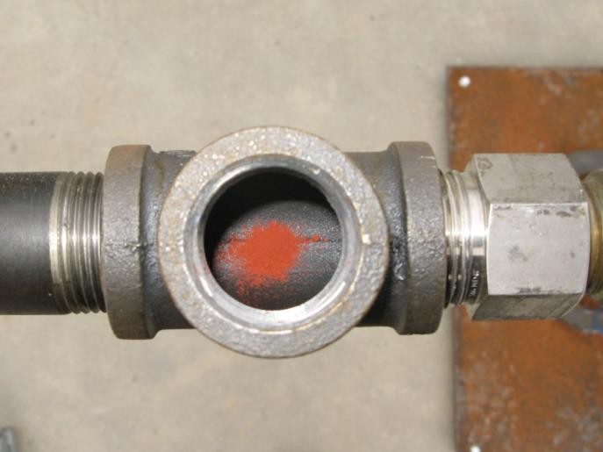
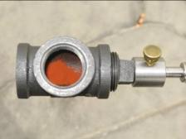
Particle Entrainment Locations
External Entrainment
Internal Entrainment
Internal Entrainment Connector
(Sealed for Test)
Nozzle
Valve
External Entrainment Connector
Nozzle
Iron Oxide
Particle Entrainment Tube
(Open for Test)

